Slide 1
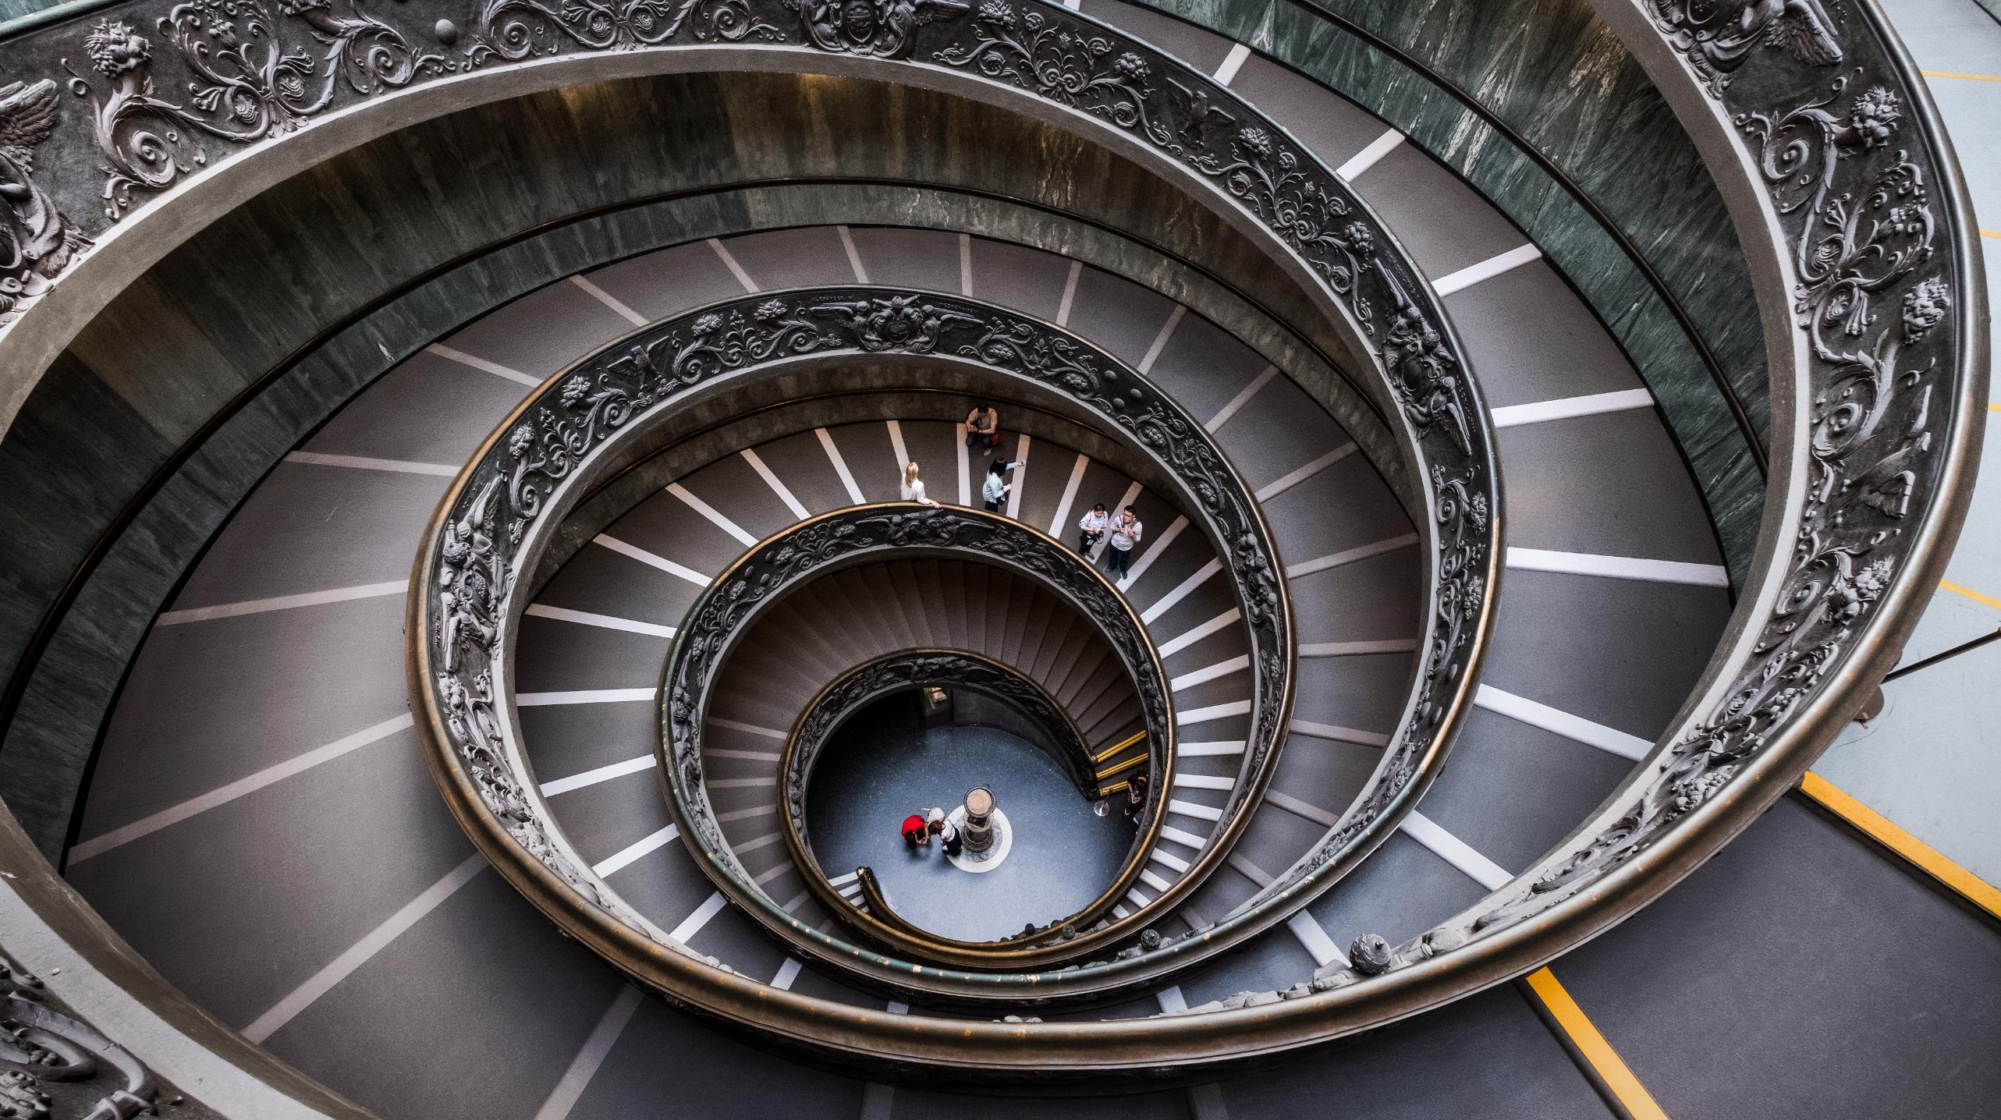
Artistic Shanghai
1N2D Package Tour

Slide 2
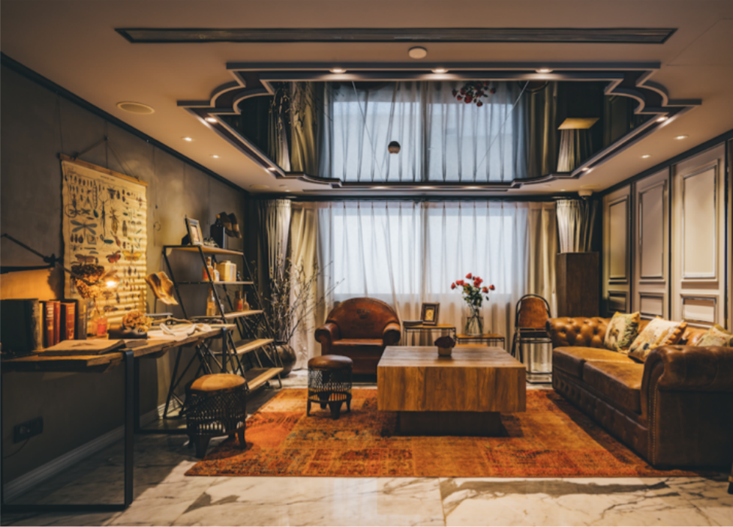
7Wonders of The World，7 Days in Shanghai
Aritistic Shanghai
Photography Tour
When you come to Shanghai, you may have been accustomed to the bustling night scenes of the Bund and Nanjing Road for decades. In fact, Shanghai is not just an imaginary bustling downtown. When you are in it, you will find that she also has a gentle and implicit side.
The city has undergone too much change since the last century. In the current reinforced concrete forest, it is also the trace of history and art.
Highlights
Notes:
To change the image behind the Mock up.
Select the layer - > Right Click -> Send to Back -> Delete the image -> Drag & Drop your Own Picture -> Send to Back (again)

Slide 3
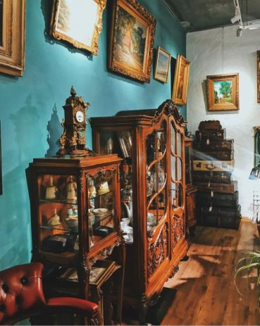
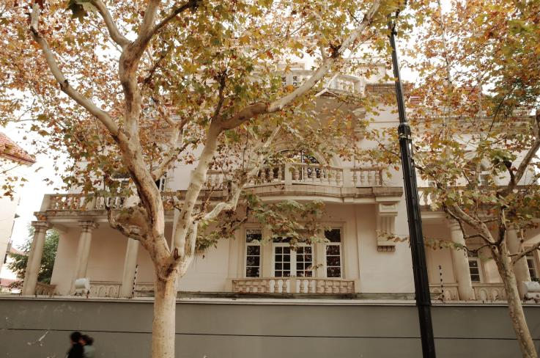
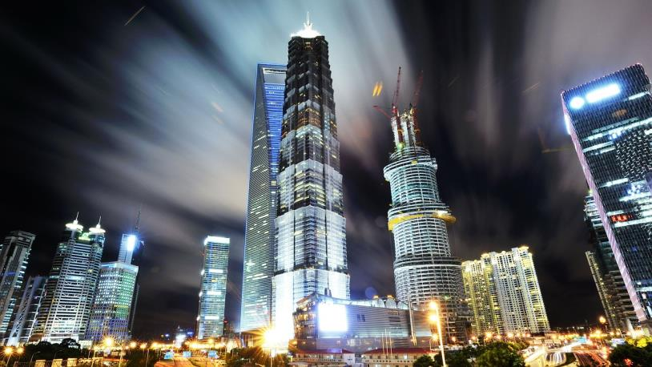
Highlights.
Art Theme Tour
Senior Tour Guide
By passing Traditional sights,
select arty niche attractions.
A professional and profound tour guide is essential for the journey of literary and artistic traceability.
Uncover the veil of the past and let the scene reappear in front of you.
The Drama Theme Hotel
Stay in China's first drama theme hotel.
Full car service
Enjoy Quality Dining
Arrange the exclusive car according to the number of people and serve you all the way.
The itinerary covers Chinese food & western food, you can tastes the exquisite Shanghai.

Slide 4
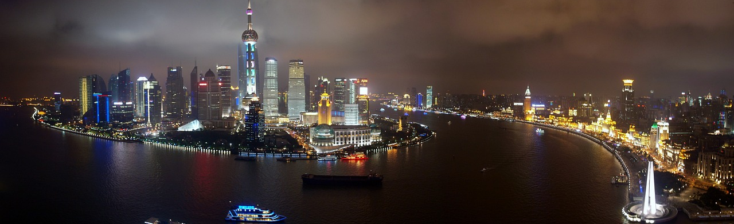
Shanghai French Concession
(Route Ferguson & Wuyuan Road & Anfu Road)
→Brunch→Tushanwan Museum→Xuhui Riverside
→Starbucks Reserve Roastery→ Hotel (The Drama)
DAY1
DAY2
Shanghai Tower→Fosun Art Center
→Shanghai Cuisine in Yuyuan Garden →M50 Art Space

Slide 5
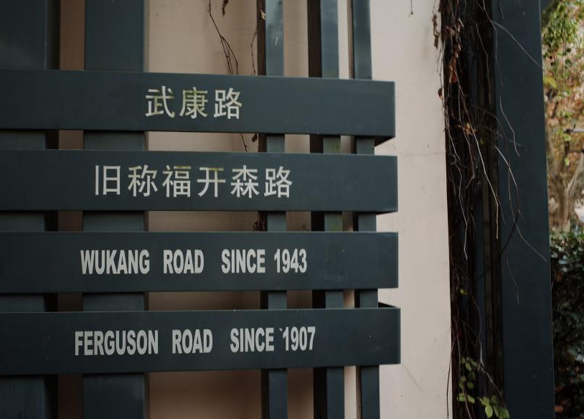
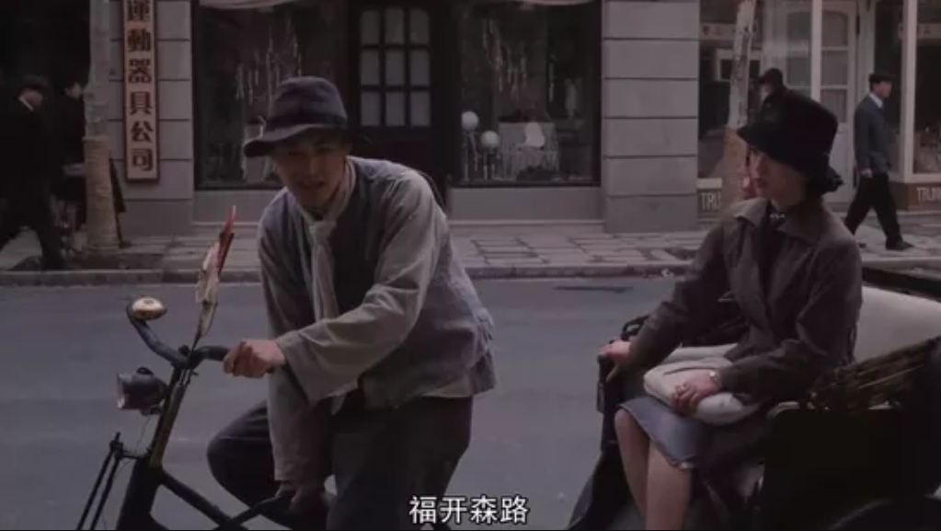

DAY1
Route Ferguson
Shanghai French Concessio
On the first day of this Renaissance tour, we will start from the old alleys of the corner of the city, appreciate the stories left over from the past, and return to the era of rushing and messy but still prosperous.

Slide 6
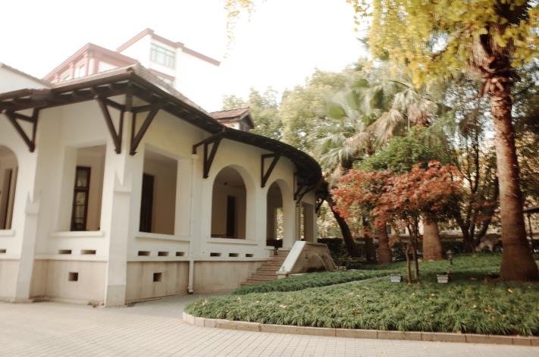
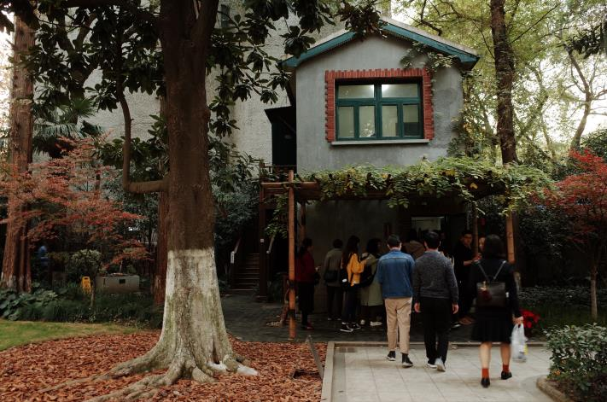
DAY1
Route Ferguson
Shanghai French Concessio
In the morning, you will be taken to Wukang Road. Wukang Road, formerly known as Route Ferguson, was named after the American missionary John Ferguson. It was built in 1907 by the Shanghai French Concession Bureau.
At the end of the movie "Lust · Caution", the actress called a rickshaw to Ferguson Road. No one knows what happens next.
So why did Director Ang Lee set her last place to be "Ferguson Road"?
Because in reality, Ferguson Road, is always a mysterious place in Shanghai.
It is known as the “Celebrity Road that enriches the history of Shanghai in the past 100 years“. Listen to the tour guide to explain the legendary life, walk along the Road, as if into a time tunnel, through a century.

Slide 7
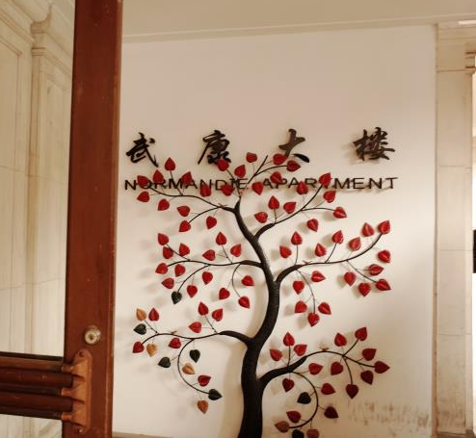
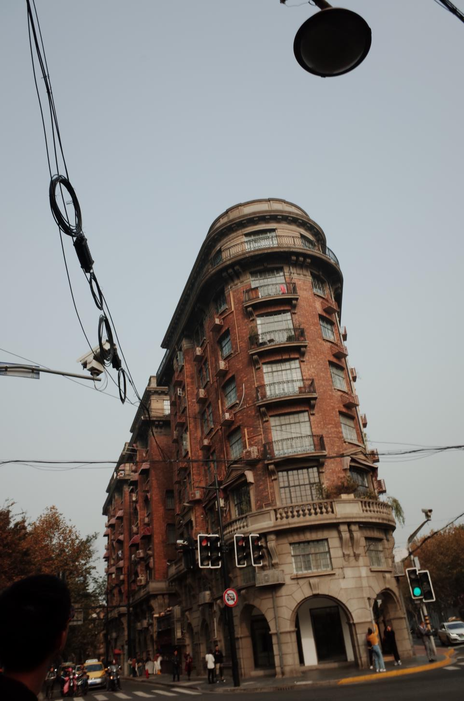
DAY1
Route Ferguson
Shanghai French Concessio
On Route Ferguson, there is a masterpiece of the now-famous Hudak architect, originally known as Normandie Apartment. It was built in 1924. Many celebrities used to live here, leaving legends that cast a mysterious veil on the building...
"In those days, many people can not stand the suffocating persecution, or to pester disease. They resolutely walked into the building and jumped down to give their souls a permanent relief.”

Slide 8
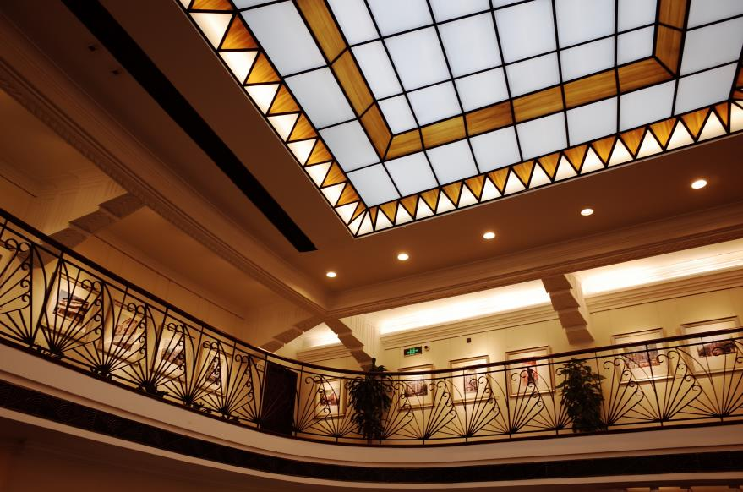
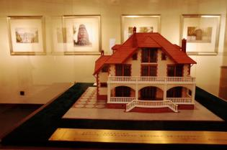
DAY1
Wuyuan Road
Anfu Road
Shanghai French Concessio
Wuyuan Road is a rare road in Shanghai that does not have access to public transportation, every few steps you can find different architectural styles. Sitting in the Café on Anfu Road, all the encounters are like a long-awaited reunion.
These houses and other buildings on these roads cover almost all the residential styles of old Shanghai, and tell the history of old Shanghai and the stories of the years. British, French, and Spanish styles tell the identity of the modern concession.
"When songs and legends have been silenced, the building is still talking."
Architecture is a solid music, a manifestation of thoughts and emotions, a living history. Each of the classic old buildings is like a vivid history textbook, with enduring historical allusions and cultural stories. The old house solidifies its "soul" and "shadow" in the cultural spirit and cultural heritage of the city. To read a city, you should first read from this old house full of vicissitudes and richness.

Slide 9
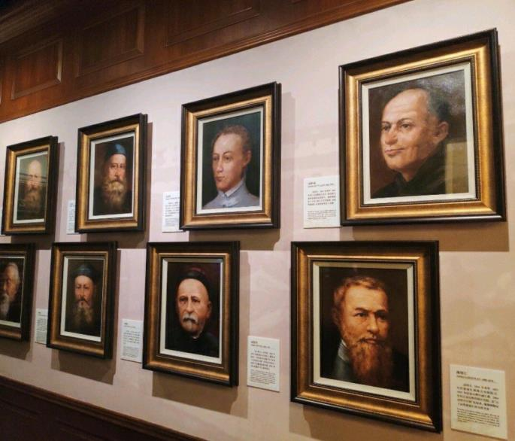
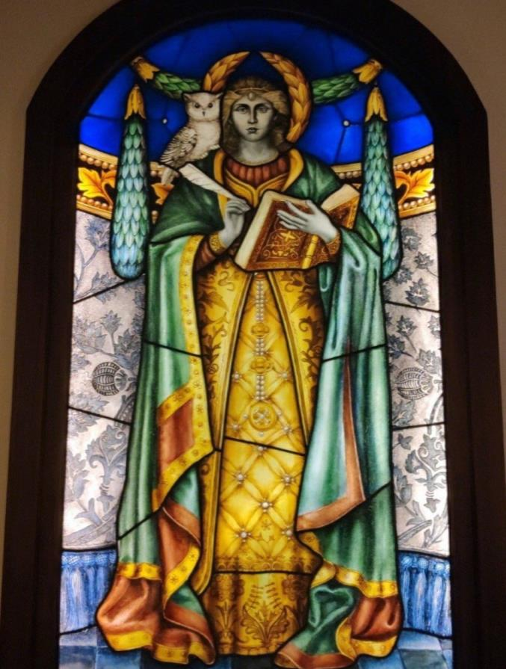
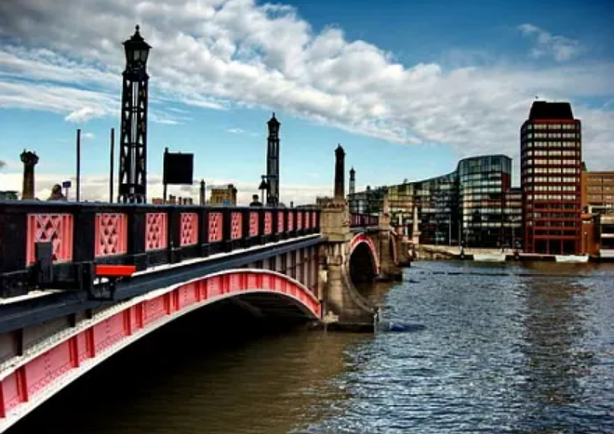
Tushanwan
Museum
DAY1
Tushanwan
Museum &
Xuhui Riverside

Slide 10
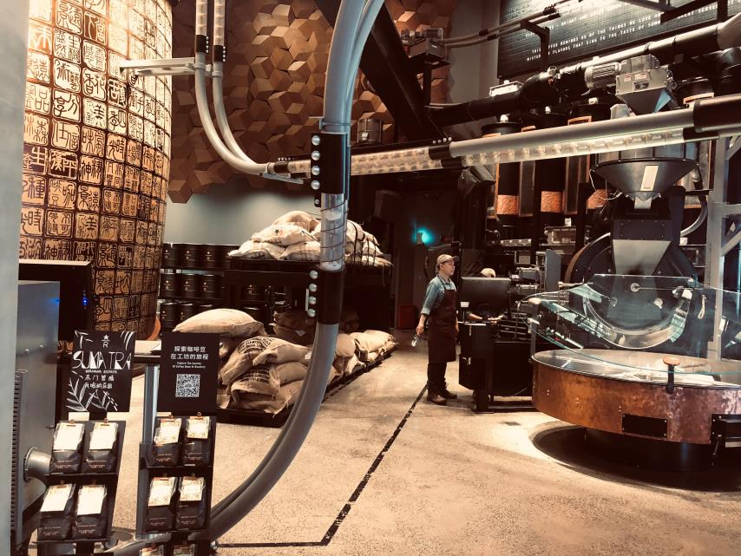
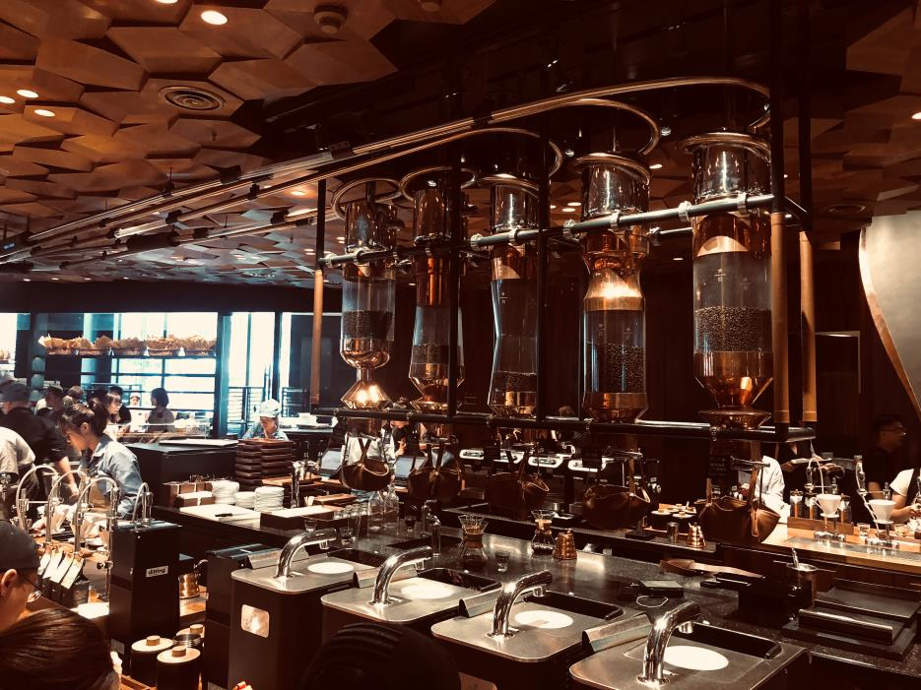
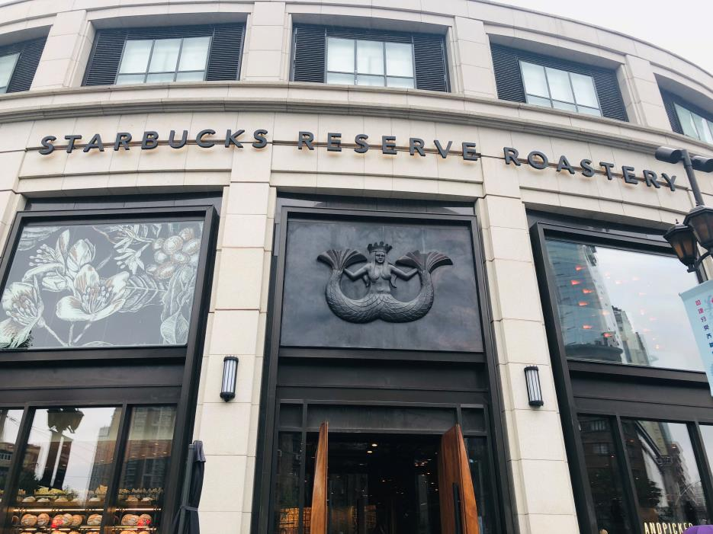
Starbucks Reserve Roastery
DAY1
Starbucks
Reserve Roastery

Slide 11


Accommodation Hotel
Inspired by Shakespeare's plays, The Drama is the first theatre-themed hotel in China, combining theatre, performances, films and other art forms to create a fun-filled experience. Into the red door, as if to enter the era of Shakespeare's drama.

Slide 12
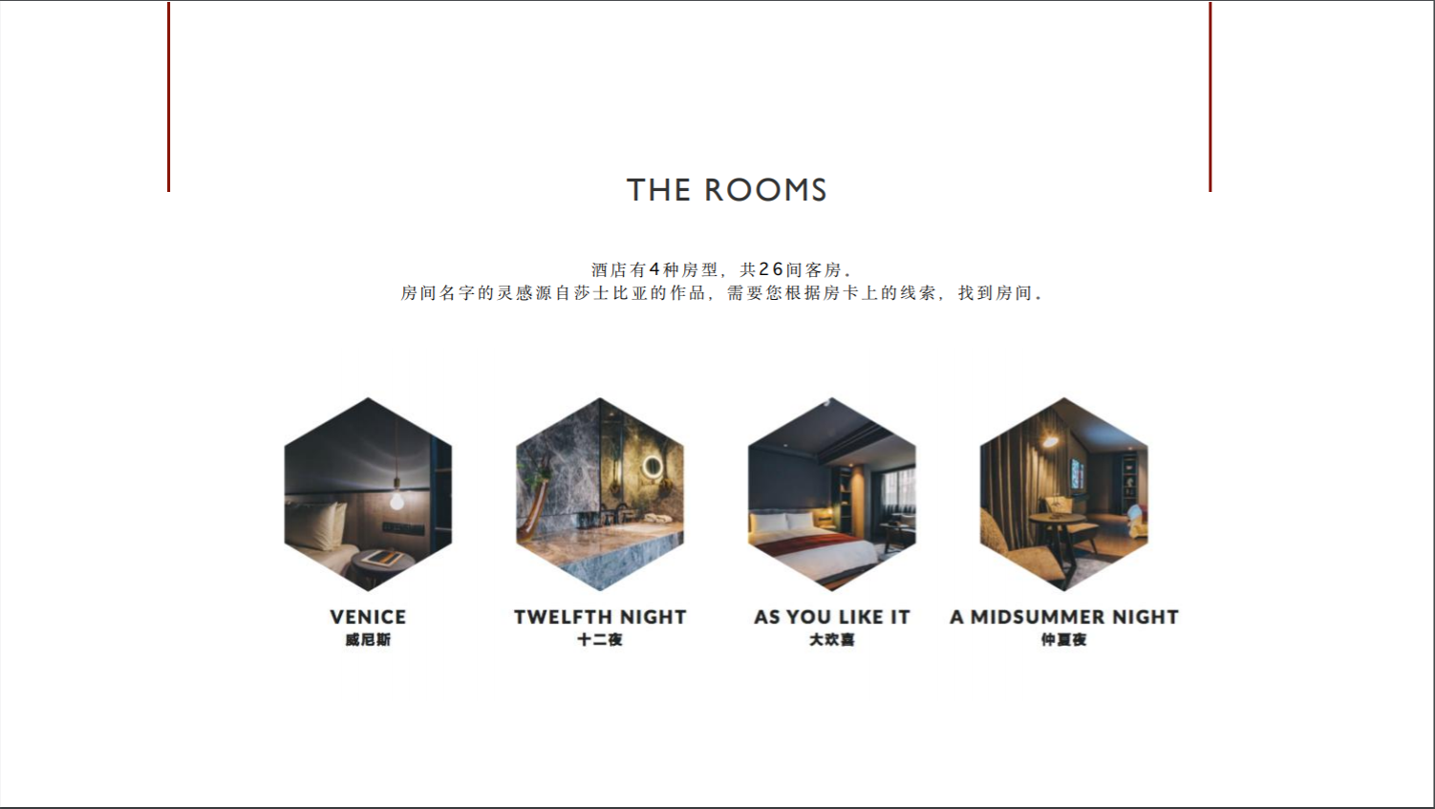
The names of The Drama's room kinds are inspired by Shakespeare's work and require you to find your room based on the clues you get.

Slide 13
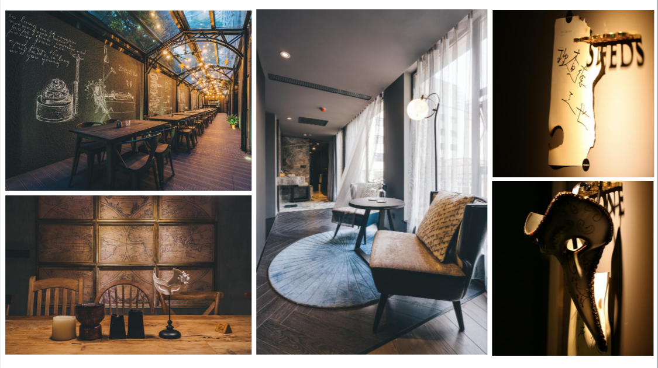

Slide 14
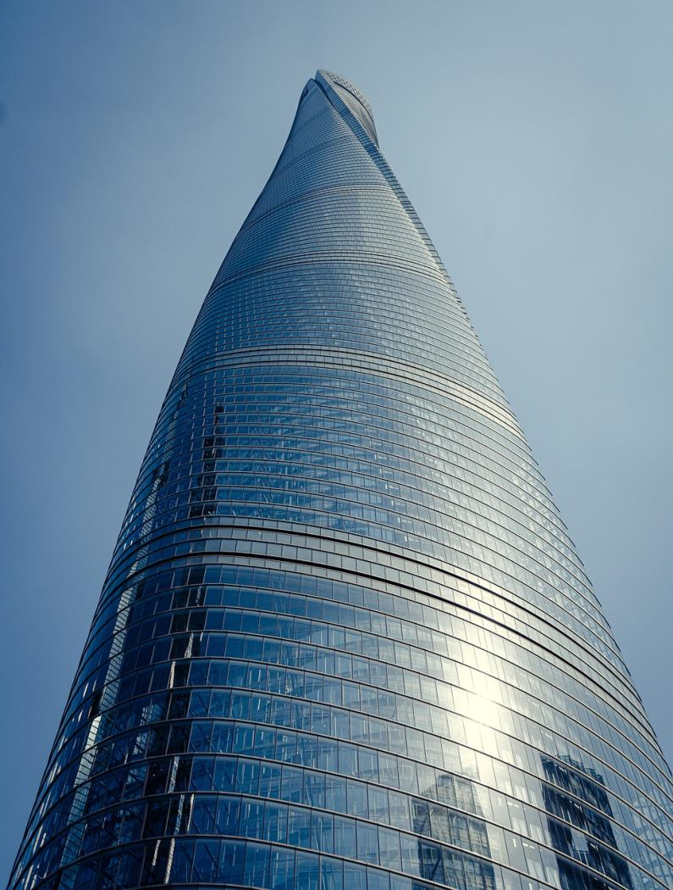
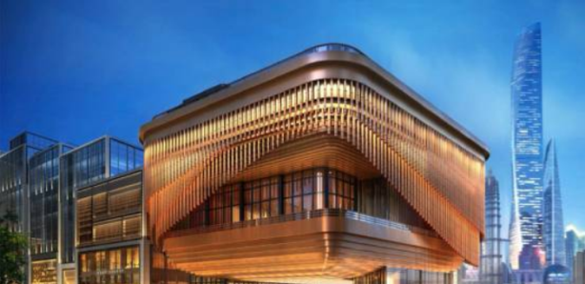
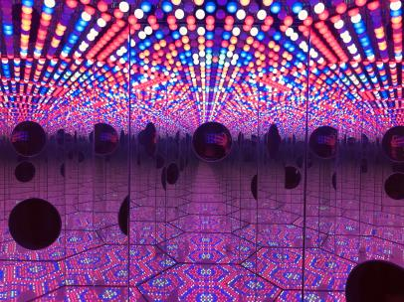
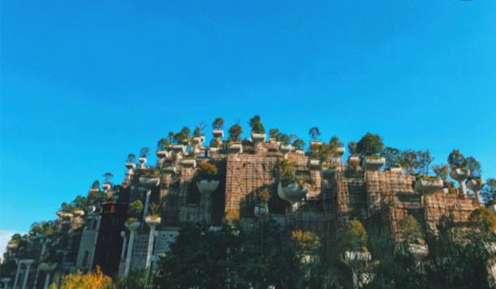
Shanghai Tower
“ Top of Shanghai‘” sightseeing hall on the 118th floor，632m
Day2
↖Fosun Art Center
←M50 Art Space

Slide 15
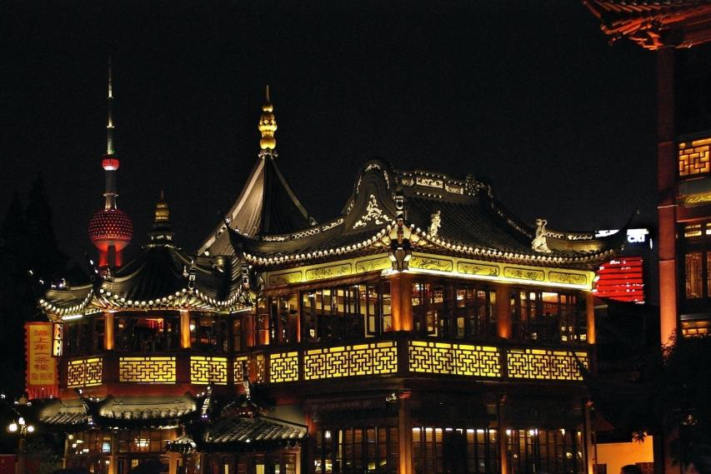
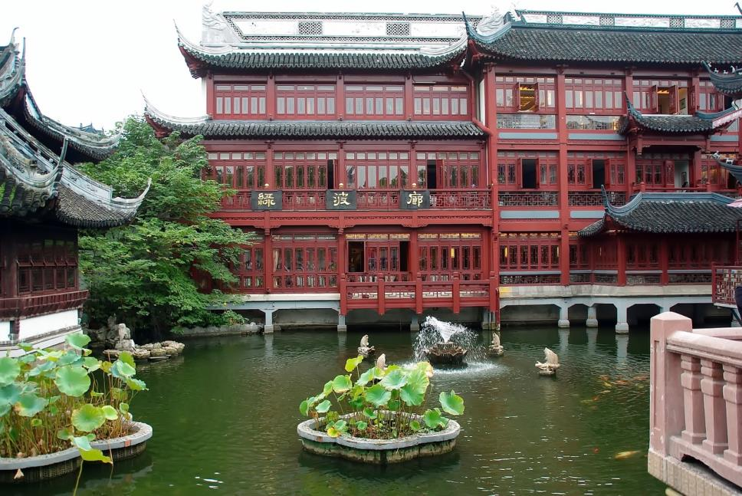
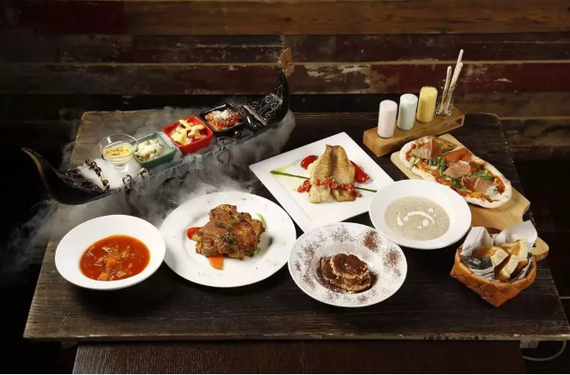
Lunches
Shanghai Cuisine in Yuyuan Garden
&
Brunch

Slide 16
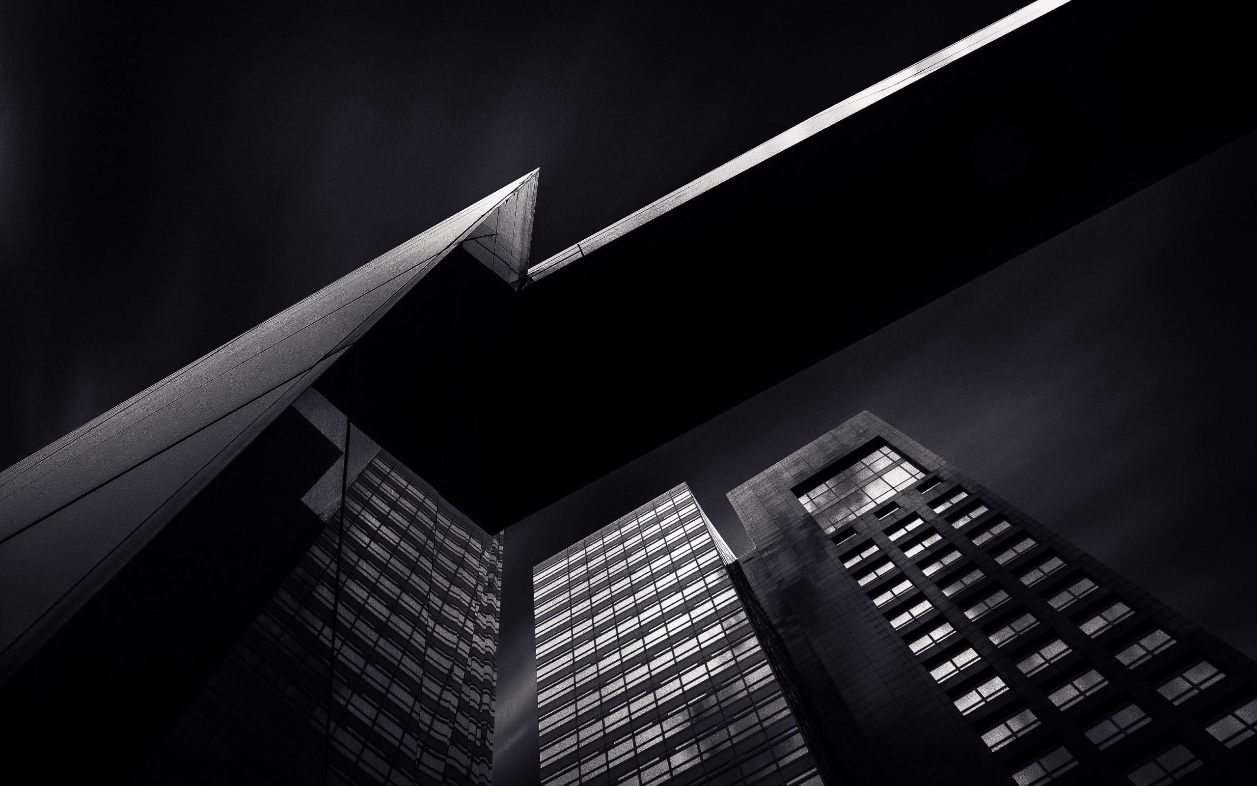

Get in Touch
H.T. CHINA - SHANGHAI HAN TANG TOUR
上海瀚唐国际旅游有限公司
T: +86 21 6333 1311
RVS@htc-tour.com
(English/Spanish Speaking)

