Slide 1
洛陽·大同·平遙
晉豫一瞥，千年中國
Shanxi & Henan
4N5D Supreme Package Tour
Hantang Tour

Slide 2
Pick-up from Datong Airport.
After lunch, you’ll visit Yungang Caves, Huanyan Temple, Shanhua Temple & Nine-Dragon Wall with English speaking guide.
Day1

Slide 3
Yungang Grottoes
Yungang Grottoes is located in the south of Wuzhou mountain north bank of Ten-Mile River.
It's a historic monument combing the Chinese culture with Western one as it is a Buddhist art treasure house of royal style, which a nationality has spent nearly a dynasty completing for the first time ever since the Buddhist art was spread to China. It was inscribed into the World Cultural Heritage List by the UNESCO in Dec. 2001 and became first group of 5A level Tourist Areas in May 2007.

Slide 4
Huayan Temple
It was built in 1038 AD and covers an area of 66,000 square meters.
Historian Zheng Zhenduo praised the clay sculpture here as "Oriental Venus". The nearly 500-square-meter Palace(The Undergroud Palace of Thousand Buddha) is made of 100 tons of pure copper, used to worship Buddha relics and thousands of Buddha statues.
Shanhua Temple
Shanhua Temple was built in the Tang Dynasty but was destroyed in the war. Then it was rebuilt in the Liao and Jin Dynasties (about 907AD - 1234AD). Today's Shanhua Temple is the most complete temple of that ancient period in China.
Nine-Dragon Wall
Listen to the story about the construction details, you will feel the greatness of the craftsman.

Slide 5
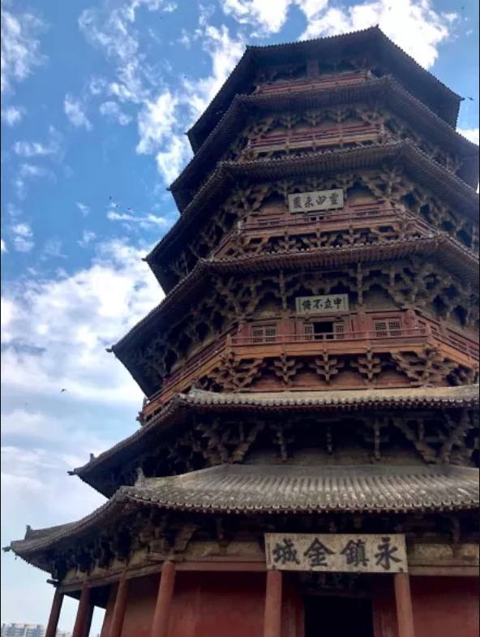
DAY 2
Yingxian Pagoda (Buddha Temple Sakya Pagoda) is located in Ying County, which was built in 1056 AD. And it is recognized by the Guinness Book of World Records as the tallest wooden tower in the world.
Yingxian Pagoda is the oldest and tallest pure wood mortise and tenon joint structure in China. It is also known as one pf the "three wonder pagodas of the world" along with the Leaning Tower of Pisa and the Eiffel Tower.
Yingxian Pagoda
HANTANG TOUR

Slide 6
DAY 2
Hanging Temple
Hanging Temple was built into a cliff (75 meters above the ground) of Mount. Hengshan. It is also the most famous scenic spot here. Originally constructed in Northern Wei Dynasty (386-557) by only one person. After many times of repairs, it has became a rare high altitude building on cliff in China.
Seeing it from the distance you could find it hanging in the mid air miraculously, hence the name "Hanging Temple".
HANTANG TOUR

Slide 7
DAY 3
Pingyao Ancient City One-day tour
Pingyao is a small city whose old town is on the UNESCO World Heritage List. It is in Shanxi province, China. Pingyao's old town is typically considered the best ancient walled city in China, and is on many lists of the best walled cities in the world. The old walled city is 2.6 sq. kilometers (1 sq. mile), inhabited, mostly off-limits to cars, and constructed of cobbled streets and buildings almost entirely from the Ming and Qing dynasties.

Slide 8
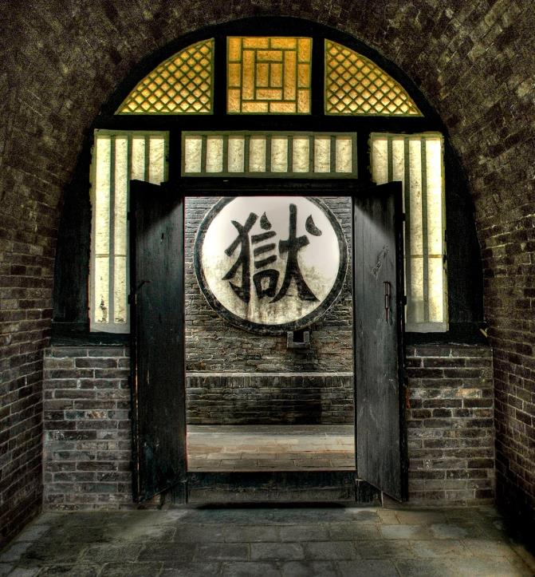
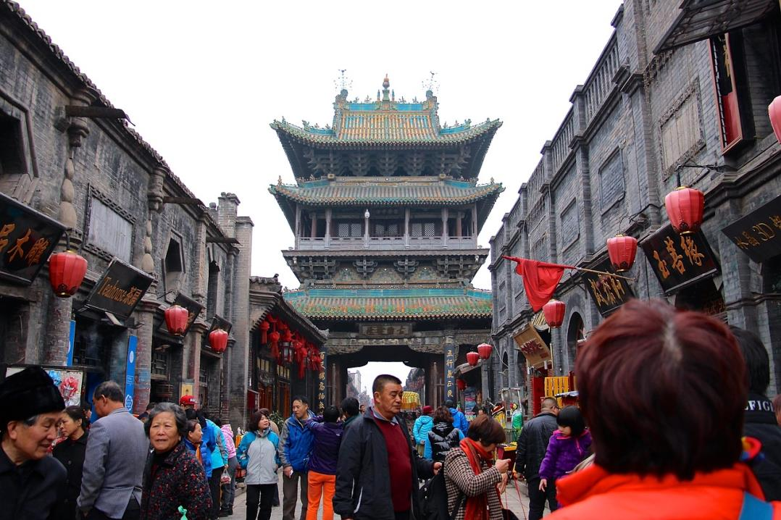
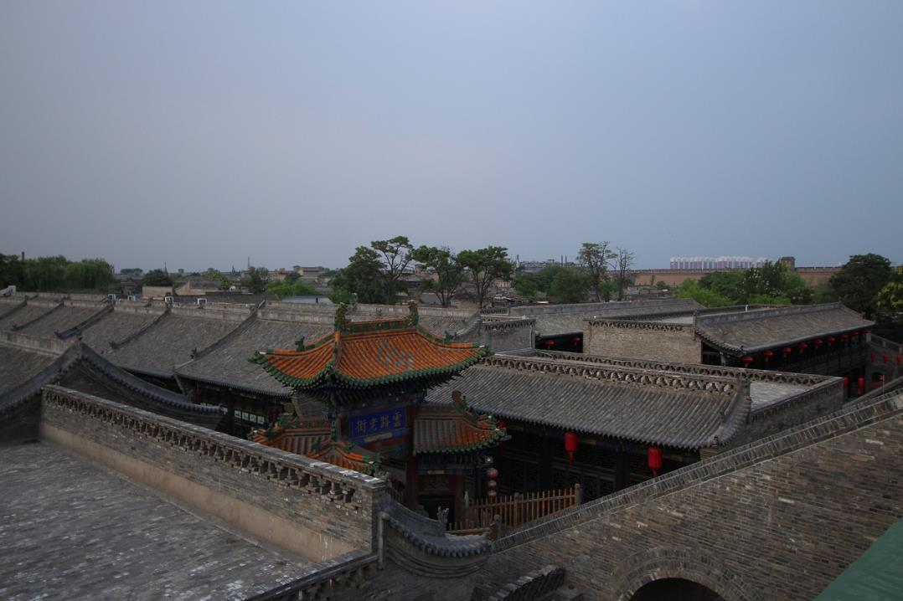
Pingyao
Ancient City
DAY3
Pingyao
Ancient City
Transfer to Pingyao, lunch in the restaurant and visit with English guide in the afternoon.
There are 78 ancient shops in the old street, including ancient banks, pawnshops, merceries and so on, let you experience the real life of ancient China, then discover the unique culture of Shanxi merchants.

Slide 9
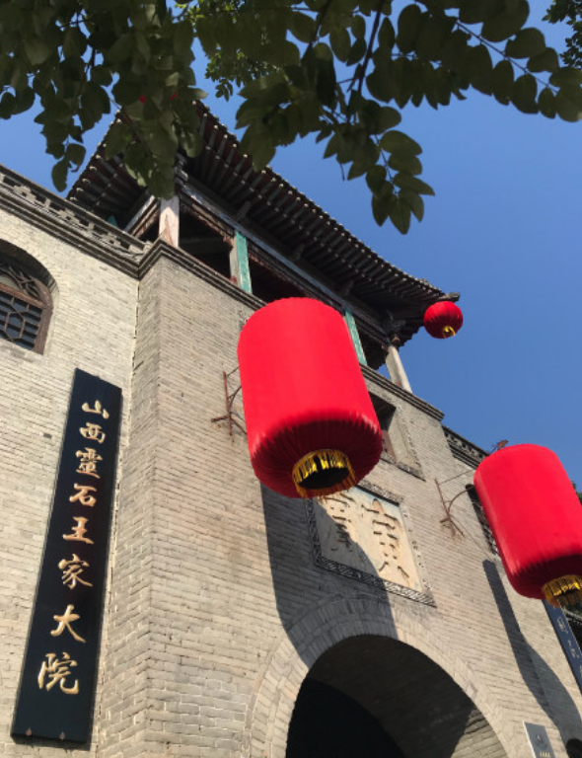
DAY 4
Family Wang’s Courtyard
--The Forbidden City in Shanxi
Shanxi & Henan 4N5D Supreme Package Tour
Family Wang’s Courtyard was built by a family surnamed Wang in Ming and Qing dynasties over 300 years, with a total area of 250,000 square meters, a museum of architectural art with traditional cultural characteristics. The culture of Shanxi merchants is vividly reflected here. It was the preferred filming place for the "Raise the red lantern" (a movie that won the Oscar Award) directed by Zhang Yimou.
Then you will go to the Shuanglin Temple that recorded in the World Heritage List. The polychrome statues here were essence of the Song, Yuan, Ming and Qing Dynasties.
After lunch, take the train to Luoyang, your guide will pick you up and then transfer to hotel.

Slide 10
In the morning, you will go to visit Longmen Grottoes,and Shaolin Temple in the afternoon. After watching the “Shaolin Kung Fu show”, you will be leaving for next stop by high speed train.
Service end.
Day5

Slide 11
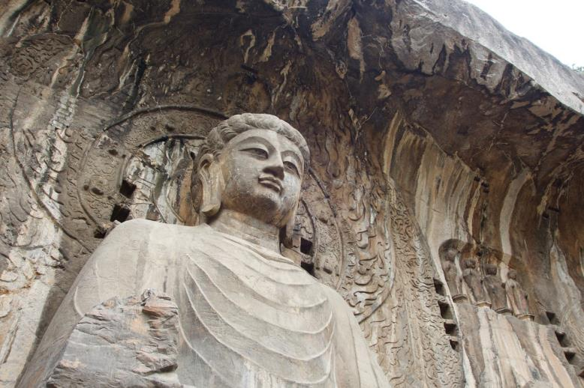
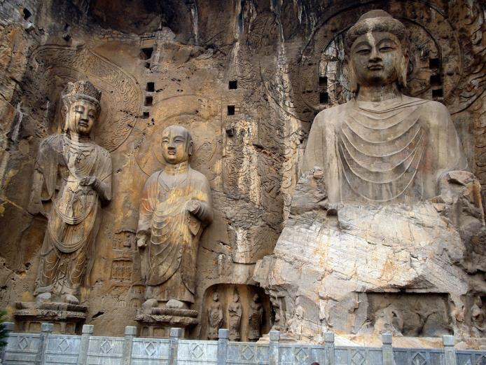
DAY 5
Longmen Grottoes
Shanxi & Henan 4N5D Supreme Package Tour
It is located 12 kilometers south of present-day Luoyang in Henan province, China. There are as many as 100,000 statues within the 2,345 caves, ranging from a 1 inch (25 mm) to 57 feet (17 m) in height. In 2000 the site was inscribed upon the UNESCO World Heritage List as “an outstanding manifestation of human artistic creativity,” for its perfection of an art form, and for its encapsulation of the cultural sophistication of Tang China.

Slide 12
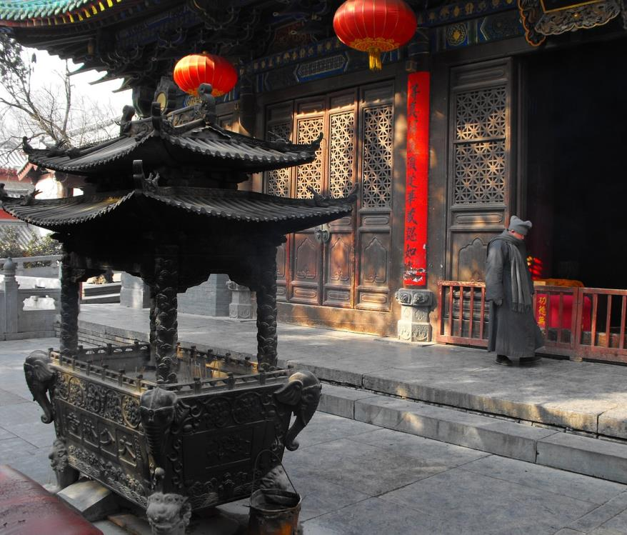
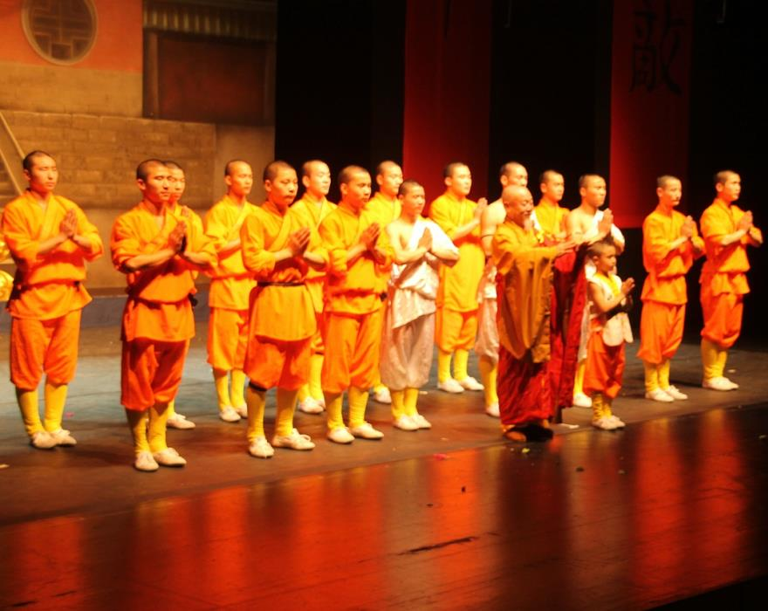
Shaolin Temple
Shaolin Temple is one of the most famous temple in China, not only because of its long history and its role in Chinese Buddhism, Shaolin Temple Pagoda but also because of its martial arts or Wushu Chan.
Shaolin Temple is situated in the beautiful Songshan Mountains. Shaolin Temple was established in 495 during the Northern Wei Dynasty (386-534). It is the birthplace of Chinese Zen Buddhism and Chinese kung Fu.
You will also enjoy the performances by the disciples of authentic Shaolin Kung Fu Show.

Slide 13
Get in Touch
H.T. CHINA - SHANGHAI HAN TANG TOUR
上海瀚唐国际旅游有限公司
T: +86 21 6333 1311
RVS@htc-tour.com
(English/Spanish Speaking)

