Slide 1
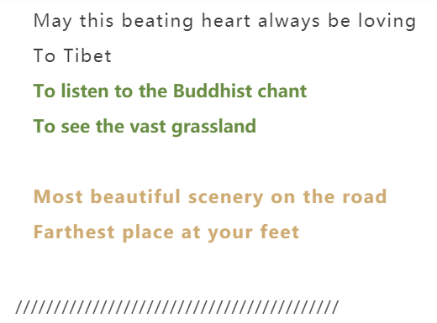
Lhasa·Tsedang·Gyangzê 7N8D
Hantang Tour

Slide 2
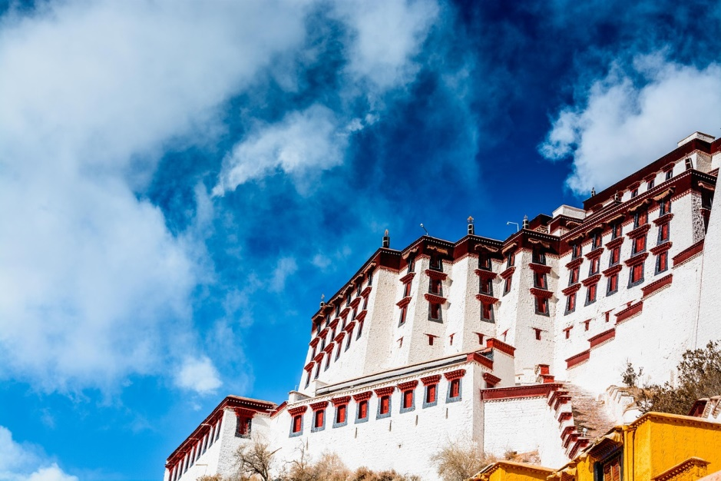
Day1
Arrive in Lhasa
Arrive at Lhasa Airport, transfer to the hotel.

Slide 3
After breakfast, guided sightseeing with the Lhasa’s cardinal landmark-Potala Palace.
In the afternoon, visit the most revered religious structure in Tibet-Jokhang Temple and the Barkhor Street.
Then transfer to the hotel.
Day2

Slide 4
HANTANG TOUR
པོ་ཏ་ལPotala Palace
Solemn and sacred
This massive 13-soreyed building used to be the highest building prior to the early period of last century, used to be the former winter abode for the Dalai Lamas. It looks incredibly magnificent from a distance and could be viewed from various places around the town. As the nation’s supreme relic, the palace dates back to 7th century A.D.

Slide 5
HANTANG TOUR
ཇོ་ཁང་
Jokhang Temple
ལྷ་སའི་བར་སྐོར།
Barkhor Street
Jokhang Temple is the convergence of Tibet’s Spiritual and secular life, like Mecca for the Muslims, here you can meet all the tribes from Tibetan plateau. The surrounding market is called Barkhor, one of the most important religious paths, which also assembles people for shopping.
Jokhang, the most sacred temple in Tibet, refers to “Buddha’s House” in Tibetan language because the main statue enshrined is said to be made by Buddha Sakyamuni himself in his lifetime

Slide 6
After breakfast, guided sightseeing with Drepung Monastery. Visit the Norbulingka Summer Palace & Sera Monastery after lunch. Then transfer to the hotel.
Day3

Slide 7
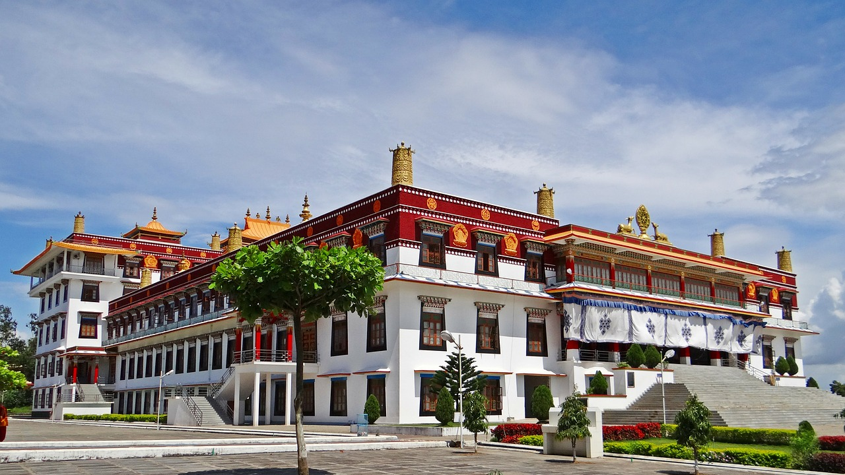
Drepung Monastery
Built in 1416, the Drepung Monastery is situated at the foot of the Mountain Gambo Utse, about 10 kilometers (3.1 miles) to the western suburbs of Lhasa. It is the largest and most influential monastery of the Gelug Sect, a branch of the Tibetan Buddhism. Together with the Ganden Monastery and the Sera Monastery, Drepung Monastery is regarded as one of the "Three Great Monasteries" in Lhasa.

Slide 8
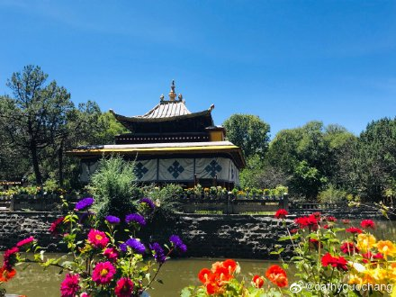
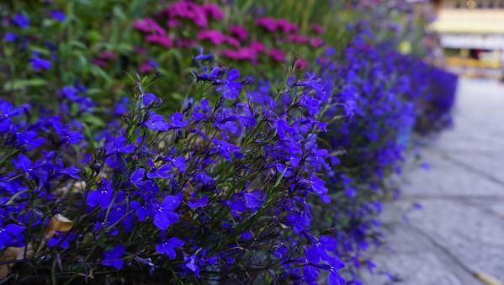
HANTANG TOUR
Norbulingka
Summer Palace
Norbulingka means a precious garden. It was built in the 1840s.
After more than two hundred years of expansion, the garden covers an area of 360,000 square meters, with more than 100 kinds of plants. There are exotic flowers and plants from the north and South foothills of the Himalayas, precious flowers transplanted from the mainland or introduced from abroad.
Sera Monastery
It was founded in 1419 by Sakya Yeshe, a disciple of Tsongkhapa. The “Buddhism Scriptures Debating” in Sera is very famous.

Slide 9
After breakfast, transfer to Tsedang, guided sightseeing with the Samye Monastery. After lunch, visit the Tradruk Temple and then go back to the hotel.
Day4

Slide 10
HANTANG TOUR
Samye Monastery
The fantastic Samye monastery, believed to be Tibet's first monastery, built between 775~779.
The original building is no longer intact due to destruction caused by wars and natural disasters, but the monastery has been rebuilt each time and still remains the symbol of Tibet's national identity. Its main building is a three-story tower with an interior influenced by Tibetan, Han and Indian styles. Afternoon drive to visit Chimpu meditations cave and Nunnery🏯.

Slide 11
After breakfast, guided sightseeing with Yumbu Lhakhang Palace. After lunch, transfer to Gyangzê to visit the Naiqin Kangsang Snow Mountain and YamdrokTso, then go back to the hotel.
Day5

Slide 12
HANTANG TOUR

Slide 13
After breakfast, visit the Palcho Monastery, then leave the small town of Gyangzê to Shigatse, the second large city in Tibet. After Lunch, guided sightseeing with the Tashilhunpo Monastery, then transfer to the hotel.
Day6

Slide 14
HANTANG TOUR
Palcho Monastery
It was built in the Ming Dynasty in 1427, a typical Tibetan Buddhist monastery building with a combination of pagodas and temples. Its architecture fully represents the typical style of temple buildings in the Late 13th century to the Middle 15th century.
HANTANG TOUR
Tashilhunpo Monastery
Visit to the impressive Tashilhunpo Monastery, home of Tibet's Panchen Lama, a sprawling complex with a gigantic Maitreya (Future Buddha) statue. Various temples contain ornate reliquary chortens.

Slide 15
HANTANG TOUR
Day7
Shigatse·Lhasa
Visit Shigatse's outdoor market for some real treasures. After lunch, guided sightseeing with the Lhasa Museum, then transfer to the hotel.

Slide 16
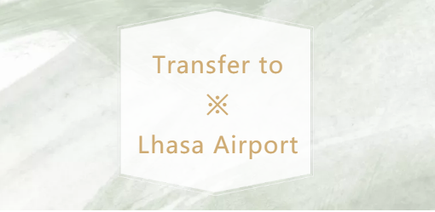
DAY8
Service End.

Slide 17
Get in Touch
H.T. CHINA - SHANGHAI HAN TANG TOUR
上海瀚唐国际旅游有限公司
T: +86 21 6333 1311
RVS@htc-tour.com
(English/Spanish Speaking)

