Slide 1
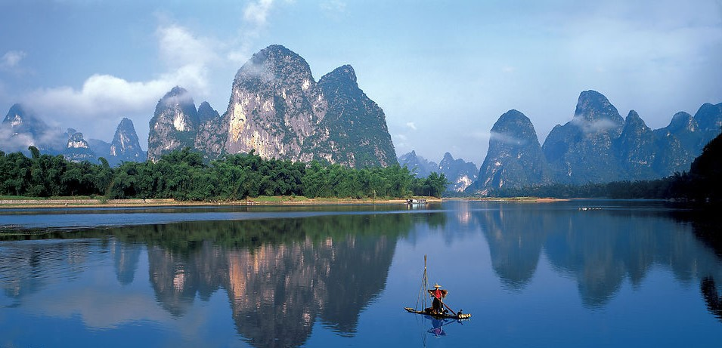
Guilin 3N4D Supreme Package Tour
Hantang Tour

Slide 2
Guilin is one of the 4 best tourist cities in China recommended by the World Tourism Organization.Its karst landforms are listed by UNESCO as the World Natural Heritage List.
It is a sacred place for human wisdom with a history of more than 10,000 years. The history of Guilin can be traced back to the Neolithic Age 12000.
Guilin
桂林

Slide 3
SCHEDULE
HANTANG TOUR
Full day tour visit to Elephant Trunk Hill & Reed Flute Cave. After lunch transfer to Longji
Terraced Fields. Then back to the hotel in Guilin.
Free time until transfer to airport for onward flight.
DAY 1
DAY 3
ARRIVAL
LI RIVER
Arrival in Guilin,
airport transfer and taking to hotel for check-in.
DAY 2
DAY4
GUILIN OUTSKIRTS
Transfer to pier for Li River cruise. Lunch will be provided on it. After arrival at Yangshuo, free time to enjoy the local area.
In the evening enjoy the show “Impression of Liusanjie”.
DEPARTURE

Slide 4
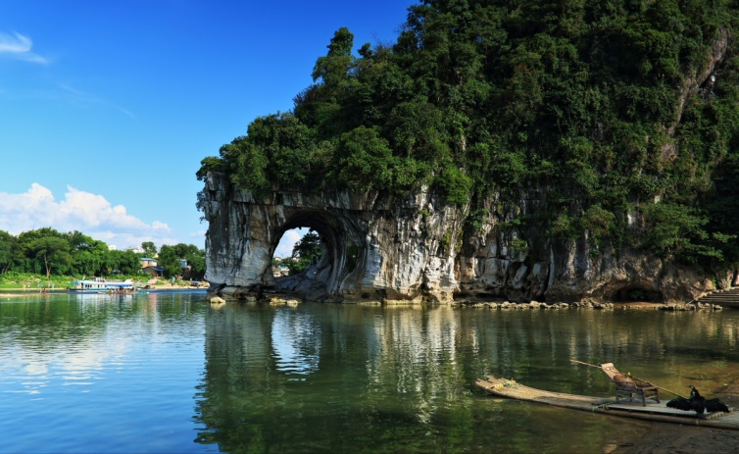
Elephant Trunk Hill
It is the badge of Guilin city. The whole hill looks exactly like a huge elephant stretching its trunk drinking water of the Li River. It is the masterpiece of karst landscape, composed of pure limestone deposited on seabed 360million years ago.

Slide 5
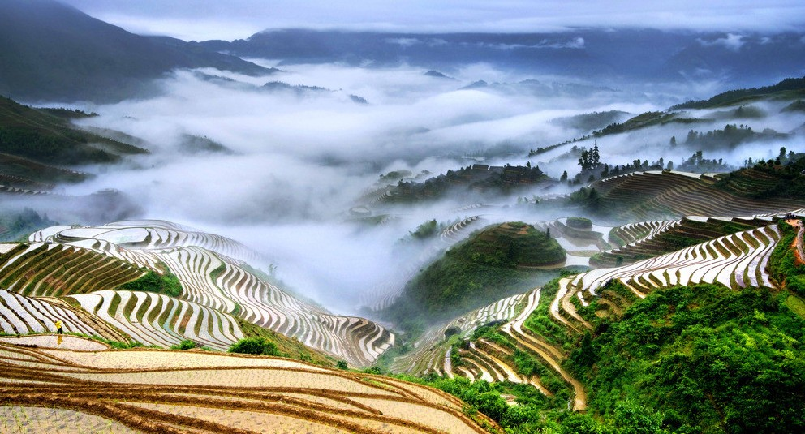
Longji Terraced Fields

Slide 6
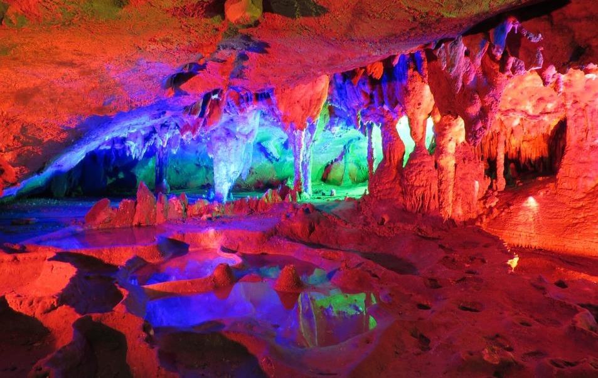
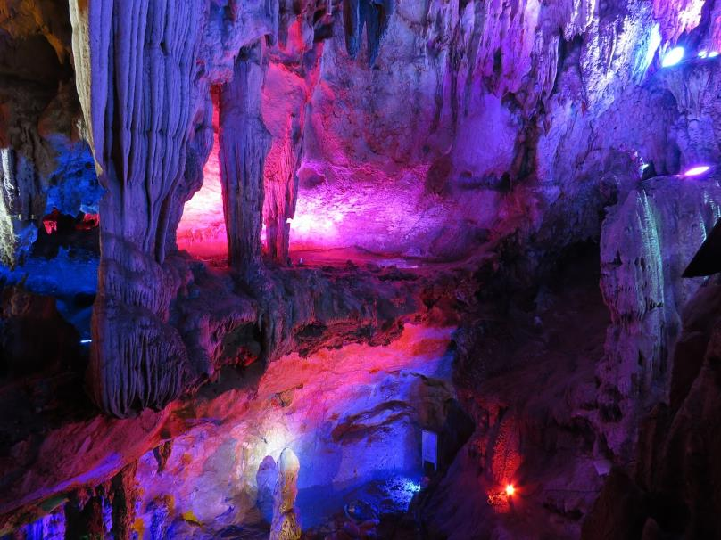
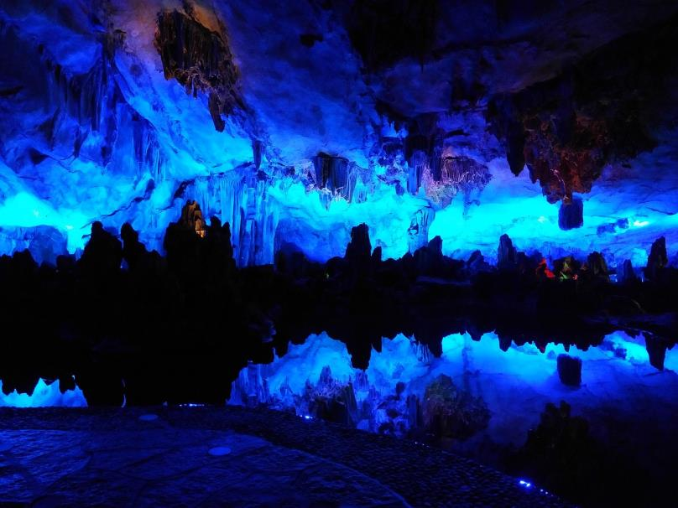
HANTANG TOUR
Reed Flute Cave
Then the Reed Flute Cave is followed for visit, Reed Flute Cave is a fascinating gallery of natural sculptures (limestone cave formations), now enhanced by multicolored lighting, which has been one of Guilin's many interesting attractions for over 1,200 years. It rates as one of the top four tourist sites in the city. The cave got its name from a type of reed growing outside, which can be made into melodious flutes.

Slide 7
HANTANG TOUR
Day cruise × Li River
The cruise will take about 4-5hours during the day. Li River flows 83 kilometres from Guilin to Yangshuo, where the karst mountains and river sights highlight the famous Li River cruise. Along the journey you may have relax time to see all the beautiful and grotesque mountain and landscape of the scenery, including the pattern on 20 yuan.
HANTANG TOUR
Impression of Liusanjie
It is a virtual scenery performance that uses the waters of Li River as the stage, 12 hills as background. With the vast sky, it consists of the largest virtual scenery theatre in the world.

Slide 8
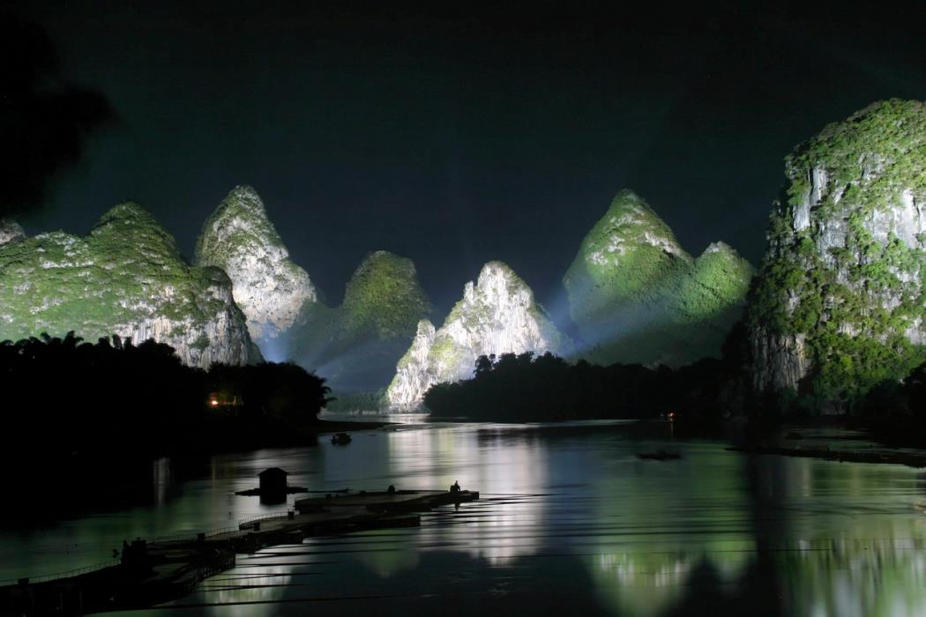
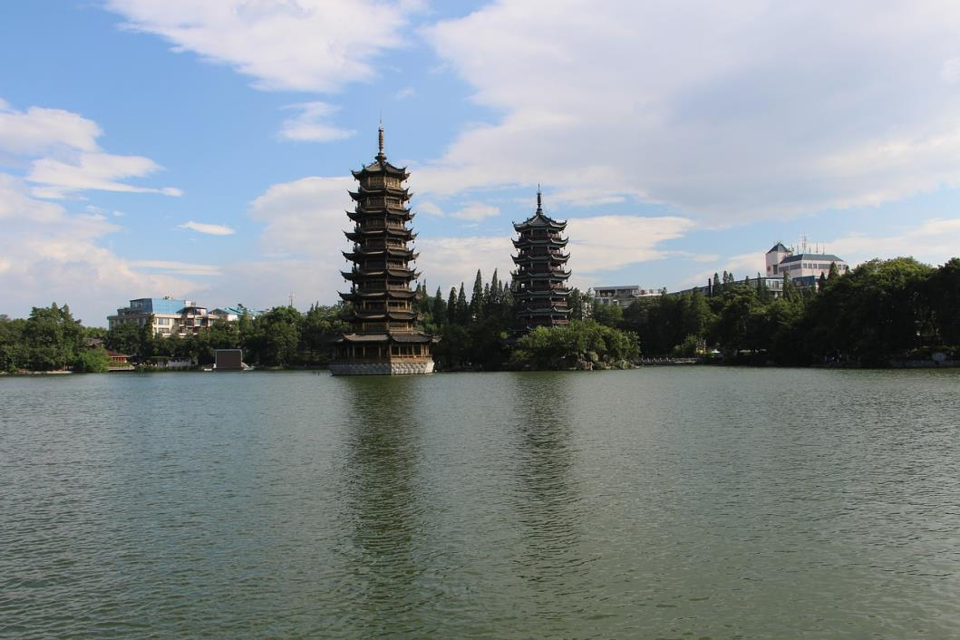
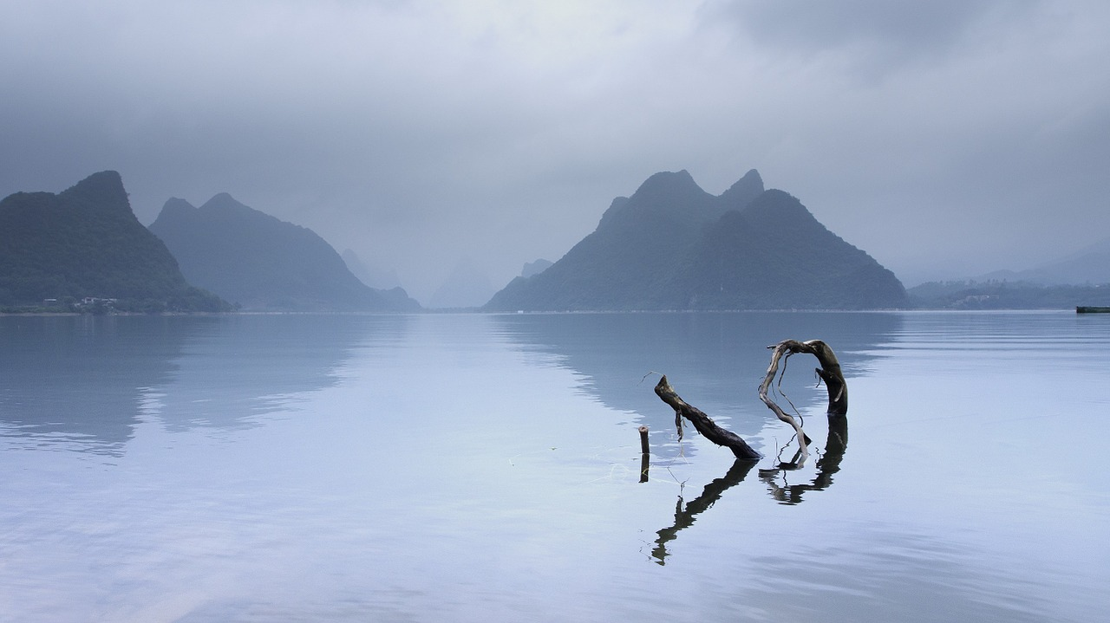

Slide 9
Get in Touch
H.T. CHINA - SHANGHAI HAN TANG TOUR
上海瀚唐国际旅游有限公司
T: +86 21 6333 1311
RVS@htc-tour.com
(English/Spanish Speaking)

