Slide 1
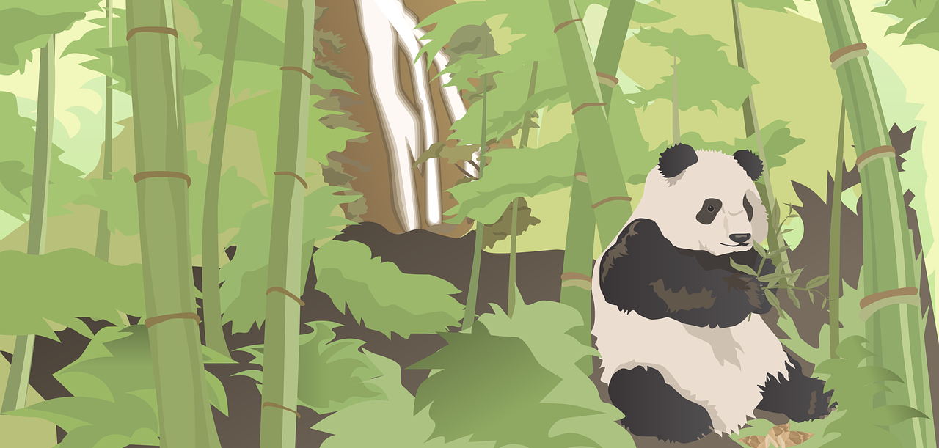
Chengdu × Mt.Qingcheng 2N3D Relaxing Package Tour
Hantang Tour

Slide 2
Every city have visited will leave a unique brand in your mind, magnificent Beijing,
modern Shanghai, avant-garde Shenzhen...
In Chengdu, outsiders rarely see its prosperity, but the life here have unspeakable comfort.
Wander around Chengdu‘s old street！

Slide 3
Arrival in Chengdu, transfer by private car.
Visit the Jin-Li Ancient Street
and
taste a cup of tea at People’s Park.
Overnight in Chengdu.
Day1

Slide 4
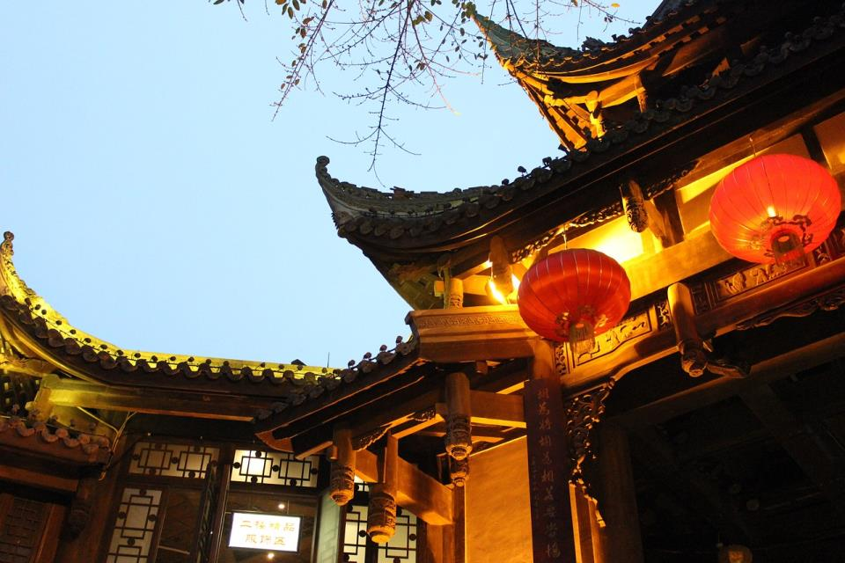
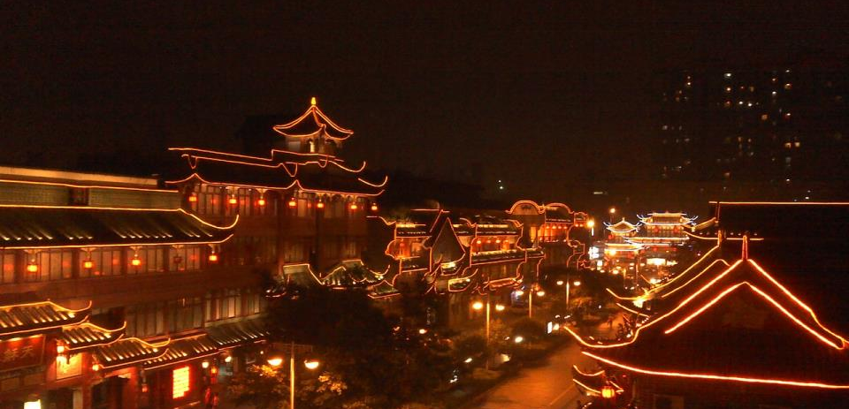
Jin-Li Ancient Street
HANTANG TOUR
Legend has it that Jinli was one of the oldest and most commercial streets in the history of Sichuan. It was famous all over the country during the Qin and Han Dynasties (221B.C.).
Today's Jinli relies on Wuhou Temple, with the spirit of Qin Han and the Three Kingdoms as its soul, has the appearance in the Ming and Qing styles and the contents of folk customs in western Sichuan. It is a must-see sight for readers who love "Romance of the Three Kingdoms".

Slide 5
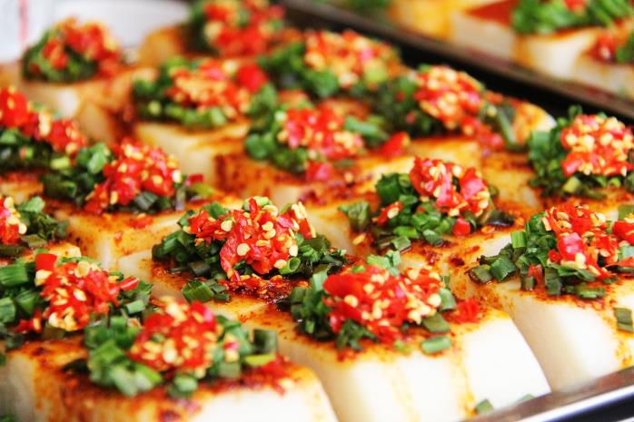
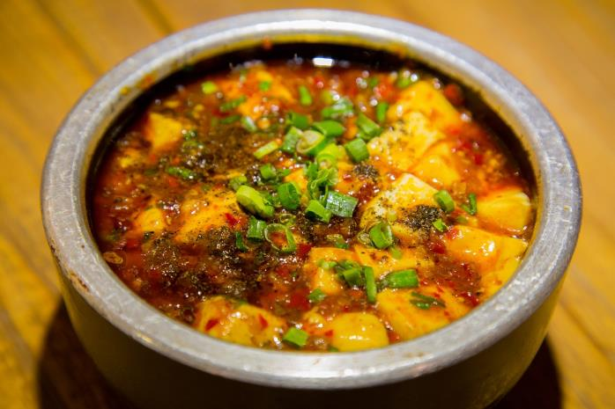
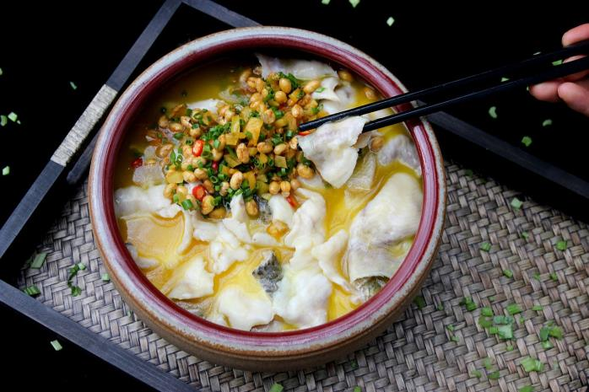
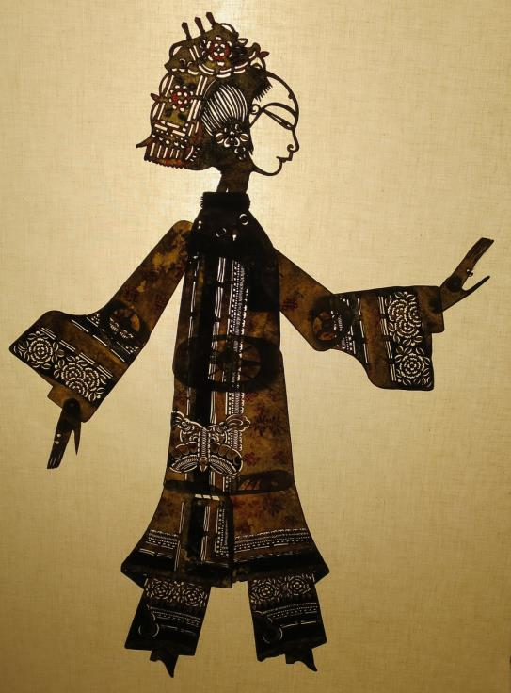
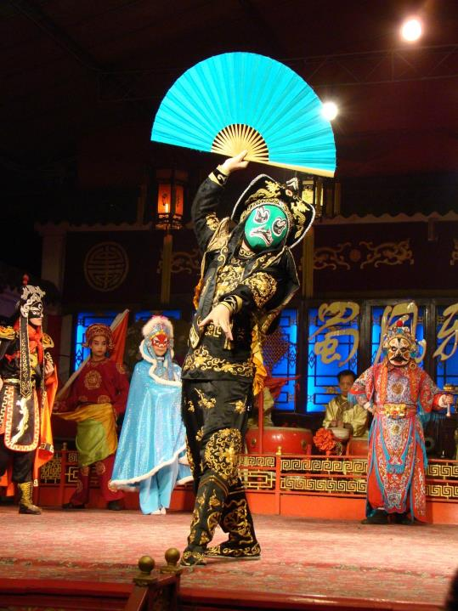
In this street, the essence of Chengdu's life is concentrated: tea houses, inns, ancient restaurants, bars, stages, snacks, handicrafts, and souvenirs, which fully demonstrate the unique charm of the Three Kingdoms culture and Sichuan folk customs.
Traditional weddings, dramas, folk costume shows and other folk performances will be held regularly, and special theme events will be held in accordance with traditional Chinese festivals, such as the Lantern Festival, the Dragon Boat Festival, the Scorpion Contest, the Chinese Valentine's Day theme event, the Mid-Autumn Festival, and so on.
Let you enjoy the most pleasant way of leisure and entertainment in an authentic atmosphere of Western Sichuan folk culture.

Slide 6
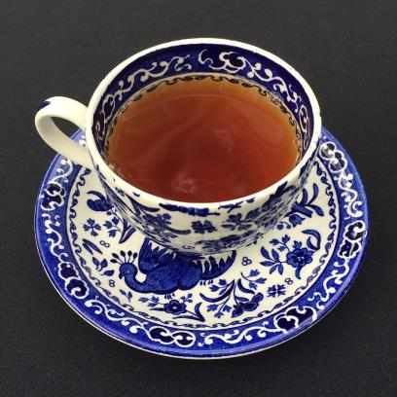
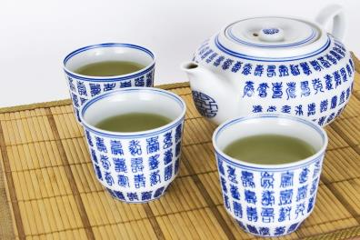
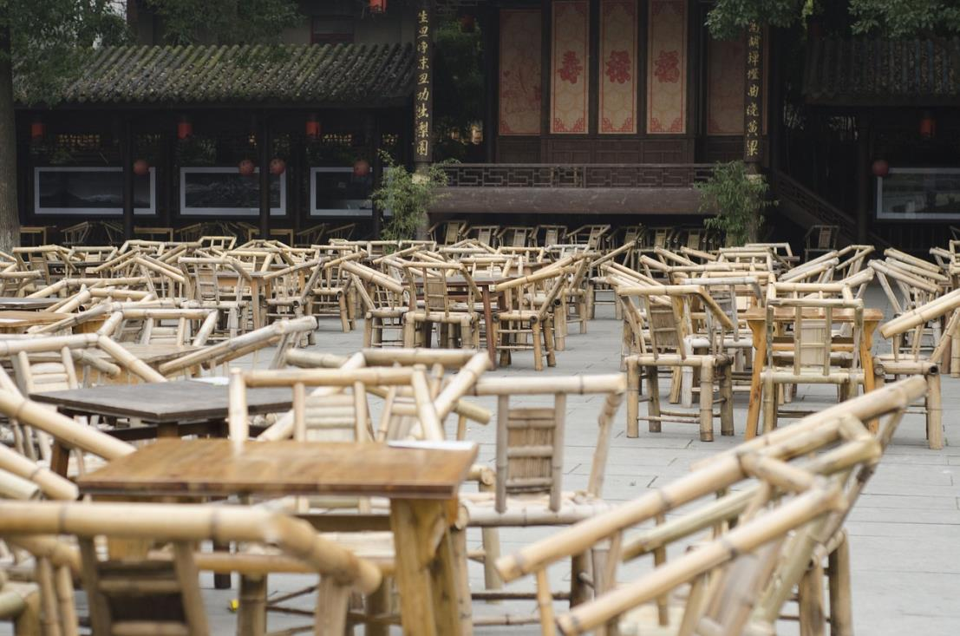
For Chengdu people, this city is not only a place of shelter, but also a place where they live with their heart. The so-called life, in addition to clothing, food, shelter and transportation, should also contain a small and definite happiness that makes you feel warm.
People's Park Teahouse is such a existence.
It's like a shortcut to escape from reality in ordinary life. Every second here can let you free from the tight constraints.

Slide 7
Day3
After breakfast, visit Dujiangyan and transfer to Mt. Qingcheng in the afternoon.

Slide 8
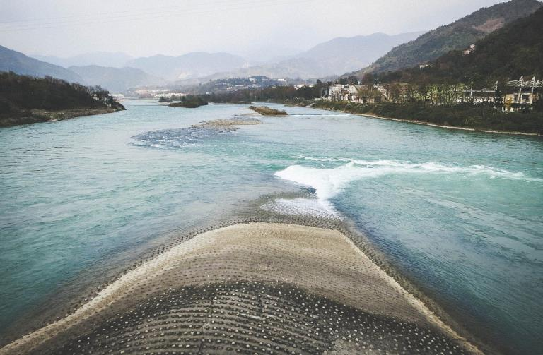
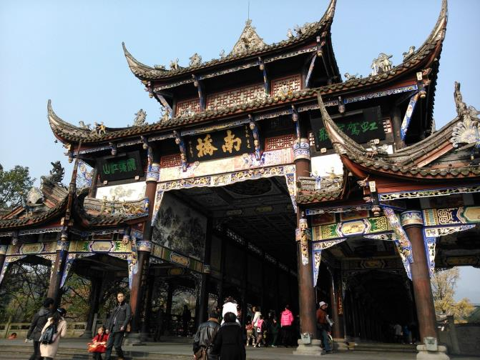
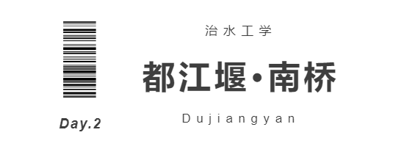
Dujiangyan, located in Chengdu and on the Minjiang River, was built in the late years of King Zhao of Qin Dynasty (about 256-251 B.C.).
It is the only large-scale water conservancy project in the world that is retained and used and characterized by dam-free diversion, while it is also the world cultural heritage and national AAAAA scenic spot, which is the crystallization of the diligence, courage and wisdom of the ancient Chinese working people.
It has been playing the role of flood control and irrigation for more than two thousand years, making the land of Chengdu plain fertile and known as the "Land of Abundance".

Slide 9
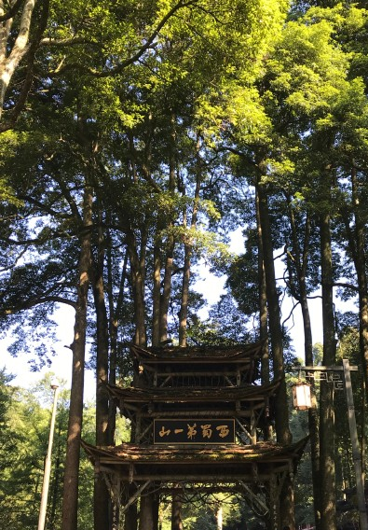
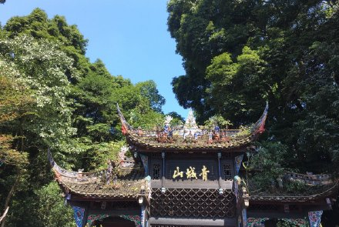
/青城山 Mount Qingcheng
Mt. Qingcheng is the birthplace of Taoism, there are many Taoist temples in the mountains. It is known as the Holy Land of Taoism in the world, one of the four famous Taoist mountains in China and one of the five immortal mountains.
It is divided into front hill and back hill. The peaks are surrounded by undulating trees and lush forests.

Slide 10
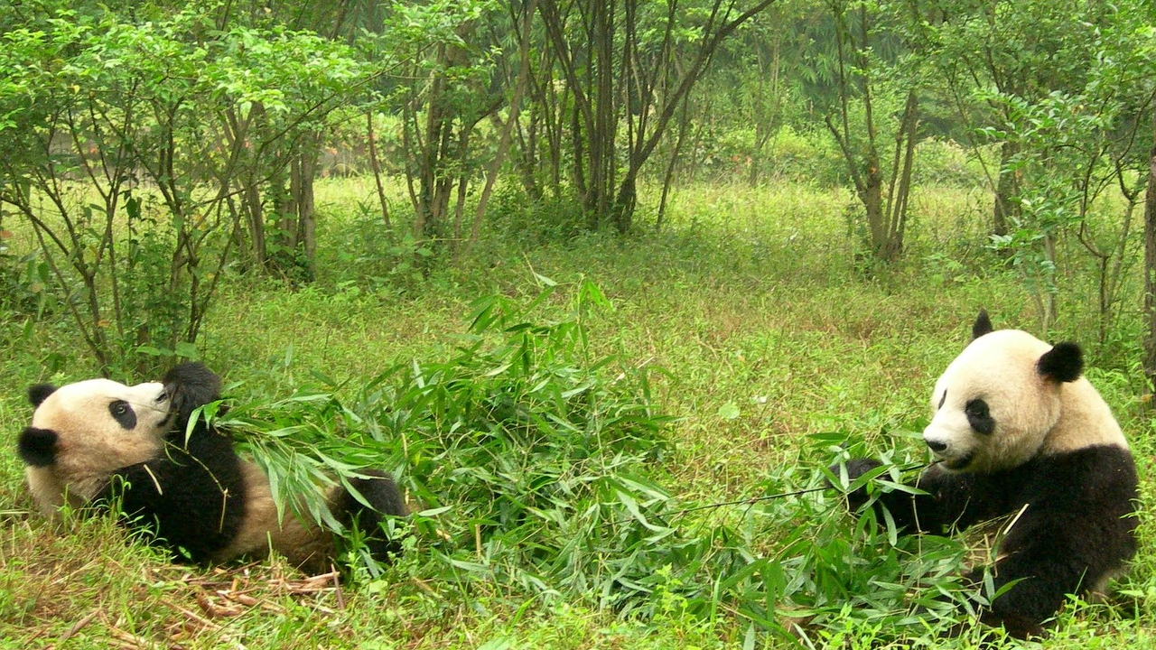
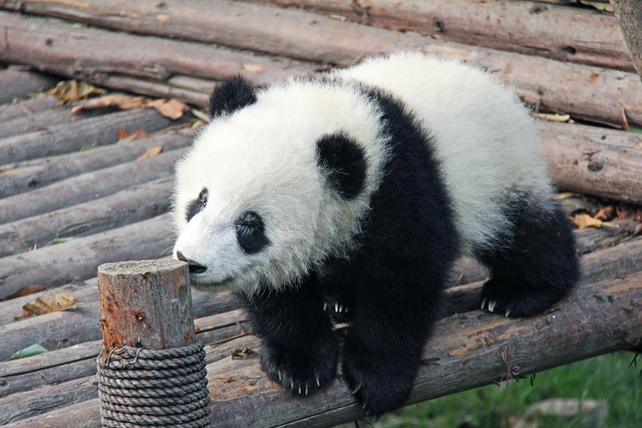
In the morning, visit the
Panda Breeding Center,
meet intimately with the cute giant panda.
After lunch, guided sightseeing with the
Kuanzhai Alley.
Day3

Slide 11
HANTANG TOUR
/宽窄巷子 Kuanzhai Alley
Kuanzhai Alley (Wide and narrow lanes) consist of wide lanes, narrow lanes and 井-shaped lanes arranged in parallel. This is also a relatively large-scale ancient street of the Qing Dynasty left over from Chengdu.
After renovation and restoration, Kuanzhai Alley officially opened in 2008 have become a microcosm of old Chengdu, showing the original flavor of Chengdu life in the combination of history and modern.
Choosing a quiet courtyard or a cane chair facing the street, sitting down to bask in the sun, drinking a cup of tea, listening to a play...
This is a typical leisure day in Chengdu style.

Slide 12
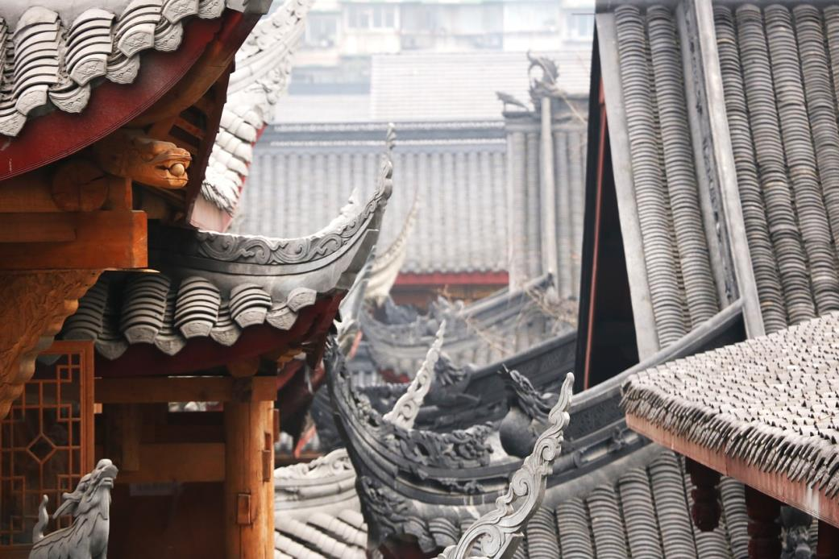
Tips for you: Be careful you may not want to leave.
Stay?
Nor is it impossible.
Chengdu is a city that you won't want to leave once you come here. The door is always open.
You are always welcome
to integrate into the life of Chengdu.
SERVICE END.

Slide 13
Get in Touch
H.T. CHINA - SHANGHAI HAN TANG TOUR
上海瀚唐国际旅游有限公司
T: +86 21 6333 1311
RVS@htc-tour.com
(English/Spanish Speaking)

