Slide 1
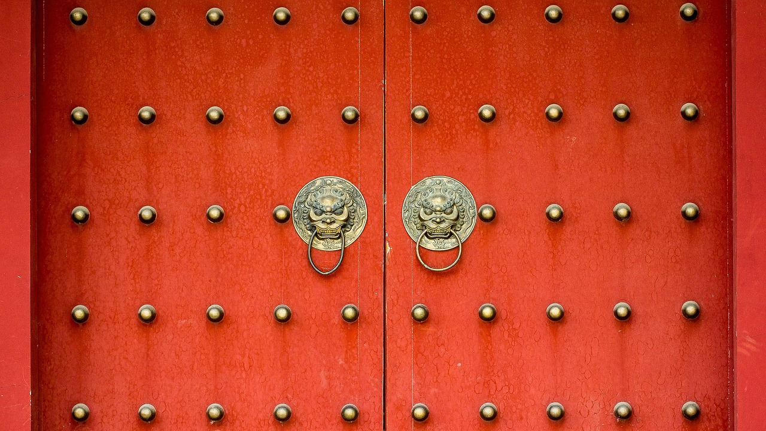
Xi'an 2N3D Supreme Package Tour
Hantang Tour

Slide 2
Xi'an, one of the world's four famous ancient capitals, is the birthplace of Chinese civilization, the cradle of the Chinese nation, and an outstanding representative of Chinese culture. It is the eastern starting point of the Silk Road. It is the capital city with the longest duration, the largest number of dynasties and the most powerful influence. Xi'an is also the earliest “World Famous Historical City” identified by UNESCO, and is known as the “Natural History Museum”.
Today's Xi'an is the capital of Shaanxi Province, one of China's six national regional center cities, the new section of the New Eurasia Continental Bridge and the largest central city of the Yellow River Basin.
Xi’an
西安

Slide 3
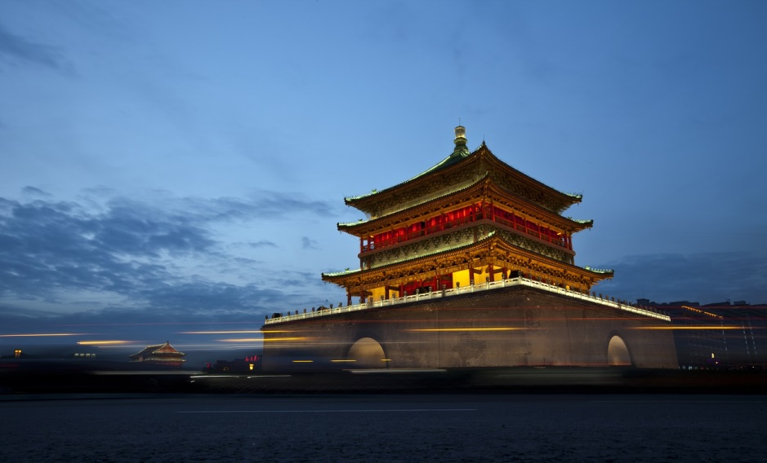
Day1
Arrive in Xi’an
Upon arrival in Xi'an, airport transfer.
The pick-up will take you to the hotel for check-in (transfer by driver only).

Slide 4
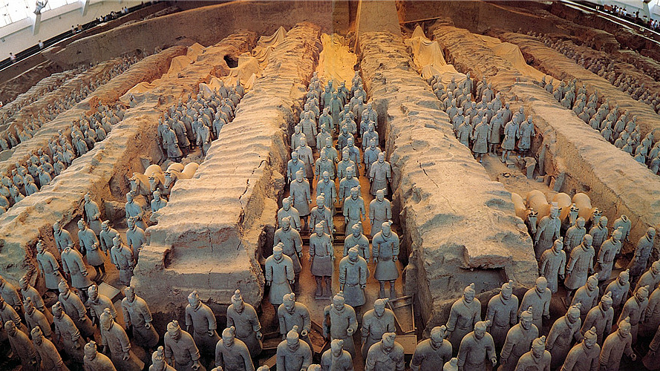
In the morning you will meet your tour guide at the hotel lobby, and drive to the Emperor Qinshihuang's Mausoleum Site Museum, then visit the Ancient City Wall.
After the tour, transfer back to your hotel in Xian’s city center.
Day2

Slide 5
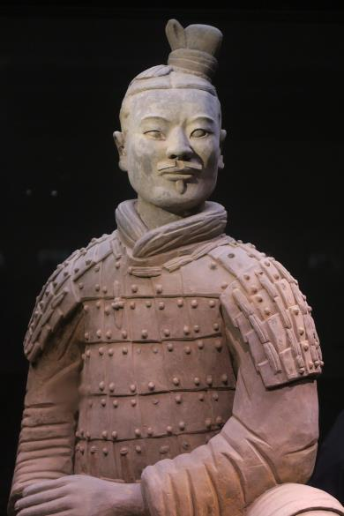
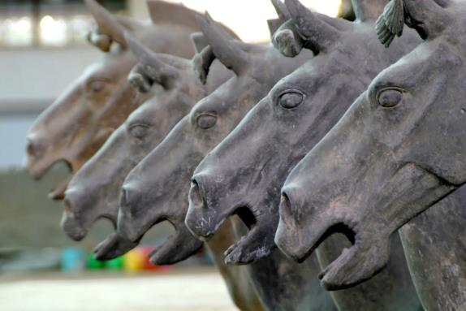
HANTANG TOUR
Emperor Qinshihuang's Mausoleum Site Museum
For the first Emperor Qin Shihuang cemetery thorough archeological investigation begins. In 1987, Qin Terracotta Warriors and Horses were listed on the World Heritage List by UNESCO and were hailed as "the eighth wonder of the world".
It is China's largest ancient military museum, made up of three different sizes of the pit composition, respectively Numbers for No.1 pit, No.2 pit, No.3 pit. More than a thousand earthen soldiers and practical weapon tens of thousands were unearthed here. Standing in front of the huge underground army, you will feel the extraordinary momentum of the emperor's sweeping of the six kingdoms and unifying the world two thousand years ago.

Slide 6
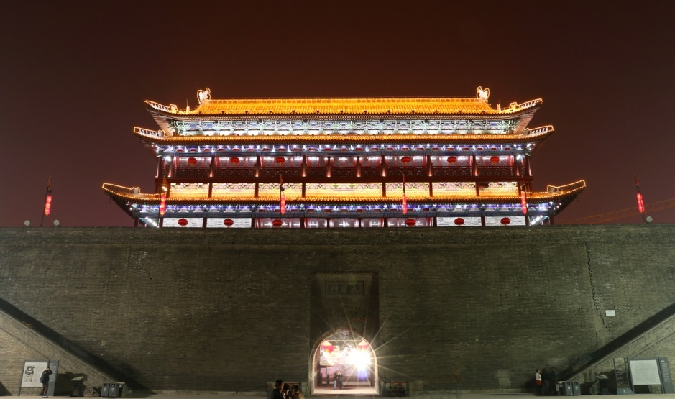
Ancient City Wall

Slide 7
HANTANG TOUR
Ancient City Wall
The ancient city wall of Xi'an is the best preserved ancient city wall in China. The city wall has four main city gates which are also the original gates of the ancient city wall. The ancient city wall of Xi'an shows the ingenuity of the working people of the ancient Han nationality in China, and also provides rare physical materials for studying ancient history, military and architecture.
Cycling on the ancient walls is a great experience. Riding on the wall, overlooking the ancient capital of thirteen, you will have a feeling through time..

Slide 8
In the morning, you will meet your tour guide at your hotel, and be taken to the Great Wild Goose Pagoda.
After lunch, you will be transferred to the airport, driver ONLY.
Service ends.
Day3

Slide 9
HANTANG TOUR
Great Wild Goose Pagoda
&
Great Ci'en Temple
The Great Wild Goose Pagoda is located in the Great Ci'en Temple in the south of the city. the Great Ci'en Temple was once a magnificent royal temple in Chang'an City in the Tang Dynasty.
Monk Xuanzang served as the first presiding chair of the temple. He supervised the Great Wild Goose Pagoda during the translation of the Buddhist scriptures at the Great Ci'en Temple.

Slide 10
Get in Touch
H.T. CHINA - SHANGHAI HAN TANG TOUR
上海瀚唐国际旅游有限公司
T: +86 21 6333 1311
RVS@htc-tour.com
(English/Spanish Speaking)

